Slide 1
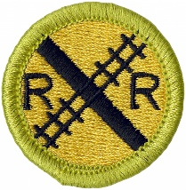
Railroading Merit Badge
Troop 344/9344
Pemberville, OH

Slide 2
Railroading Merit Badge Requirements
Do THREE of the following:
  Name three types of modern freight trains. Explain why unit trains are more efficient than mixed freight trains.
  Name one Class I or regional railroad. Explain what major cities it serves, the locations of major terminals, service facilities, and crew change points, and the major commodities it carries.
  Using models or pictures, identify 10 types of railroad freight or passenger cars. Explain the purpose of each type of car.
  Explain how a modern diesel or electric locomotive develops power. Explain the terms dynamic braking and radial steering trucks.

Slide 3
Railroading Merit Badge Requirements
Do the following:
  Explain the purpose and formation of Amtrak. Explain, by the use of a timetable, a plan for making a trip by rail between two cities at least 500 miles apart. List the times of departure and arrival at your destination, the train number, and the type of service you want.
  List and explain the various forms of public/mass transit using rail.
Do ONE of the following:
  Name four departments of a railroad company. Describe what each department does.
  Tell about the opportunities in railroading that interest you most and why.
  Name four rail support industries, Describe the function of each one.
  With your parent's and counselor's approval, interview someone employed in the rail industry. Learn what that person does and how this person became interested in railroading. Find out what type of schooling and training are required for this position.

Slide 4
Railroading Merit Badge Requirements
Explain the purpose of Operation Lifesaver and its mission.
Do THREE of the following:
  List five safety precautions that help make trains safer for workers and passengers.
  Explain to your merit badge counselor why safety around rights-of-way is important.
  List 10 safety tips to remember when you are near a railroad track (either on the ground or on a station platform) or aboard a train.
  Tell your counselor about the guidelines for conduct that should be followed when you are near or on railroad property. Explain the dangers of trespassing on railroad property.
  Tell what an automobile driver can do to safely operate a car at grade crossings, and list three things an automobile driver should never do at a grade crossing.
  Tell how to report a malfunction of grade crossing warning devices.
  List safety precautions a pedestrian should follow at a public crossing.

Slide 5
Railroading Merit Badge Requirements
Explain the appearance and meaning of the following warning signs and devices: advance warning sign, pavement markings, crossbucks, flashing red lights, crossing gates.
Do EACH of the following:
  Explain how railroad signals operate and show two basic signal types using color and configuration.
  Explain the meaning of three horn signals.
  Describe a way to signal a train for an emergency stop.
  Explain the use and function of the EOTD (end-of-train device) or FRED (Flashing rear end device) used on the last car of most freight trains.

Slide 6
Railroading Merit Badge Requirements
Select ONE of the following special-interest areas and complete the requirements:
  Model Railroading
  With your parent's and counselor's approval, do TWO of the following:
    Draw a layout of your own model railroad; or one that could be built in your home. Design a point-to-point track or loop with different routings. Include one of the following: turnaround or terminal or yard or siding.
    Build one model railroad car kit or one locomotive kit.
    Name the scale of four popular model railroad gauges. Identify the scale of four model cars or locomotives.
    Locate the website of four model railroad - related manufacturers or magazine publishers. Print information on their products and services and discuss the information with your counselor.
    Build one railroad structure (from scratch or using a kit), paint and weather the structure, mount it on your layout or diorama, and make the surrounding area on a diorama scenic.
    Alone or with others, build a model railroad or modular layout, including ballast and scenery. Make electrical connections and operate a train. Describe what you enjoyed most.
    Participate in a switching contest on a timesaver layout and record your time.
    Explain the difference between powering and controlling a model railroad by using direct current, and powering and controlling a model railroad using digital command control.

Slide 7
Railroading Merit Badge Requirements
Select ONE of the following special-interest areas and complete the requirements:
  Railfanning
  With your parent's and counselor's approval, do TWO of the following:
    Visit a railroad museum, historical display, or a prototype railroad-sponsored public event. With permission, photograph, videotape, or sketch items of interest. Explain what you saw and describe your photos, sketches, or videotape.
    Purchase tickets and ride a scenic or historic railroad. Under supervision, photograph the equipment and discuss with your counselor the historic significance of the operation.
    Locate the website of four rail historical groups, then find information on the history of the rail preservation operations and purpose of each group. Talk with a member of one of the groups and find out how you might help.
    Plan a trip by rail between two points. Obtain a schedule and explain when the train should arrive at two intermediate points. Purchase the tickets and make the trip. Explain to your counselor what you saw.

Slide 8
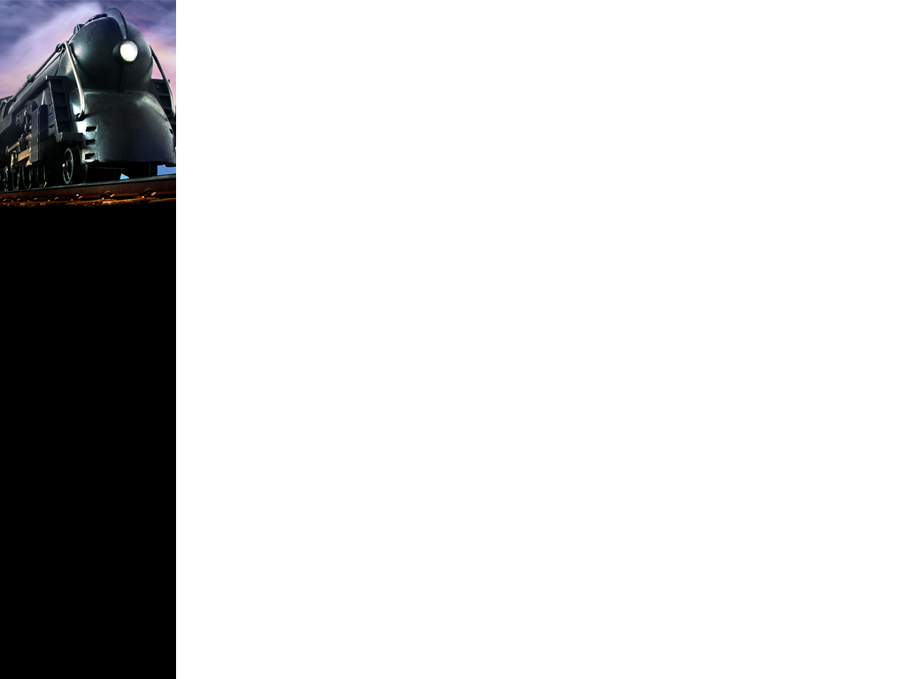
Requirement 1
Do THREE of the following:
  Name three types of modern freight trains. Explain why unit trains are more efficient than mixed freight trains.
  Name one Class I or regional railroad. Explain what major cities it serves, the locations of major terminals, service facilities, and crew change points, and the major commodities it carries.
  Using models or pictures, identify 10 types of railroad freight or passenger cars. Explain the purpose of each type of car.
  Explain how a modern diesel or electric locomotive develops power. Explain the terms dynamic braking and radial steering trucks.

Slide 9
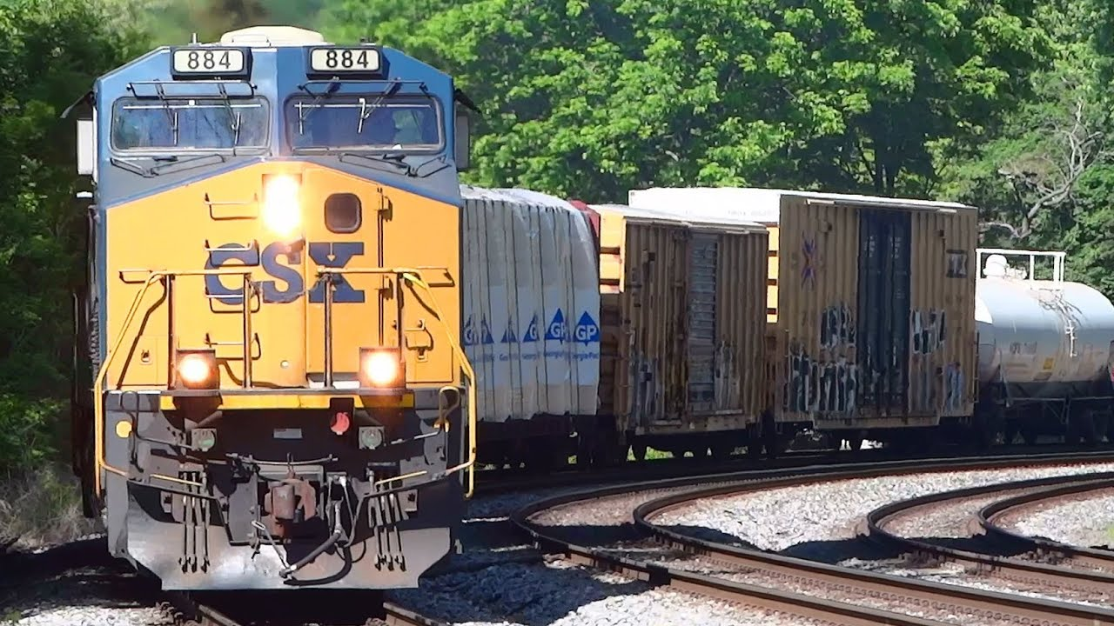
1a. Three Types of Modern Freight Trains
Mixed Freight
Mixed trains carry a variety of freight in different types of railcars.
The individual cars are ultimately headed for different destinations so the mixed train usually goes through a classification yard.

Slide 10
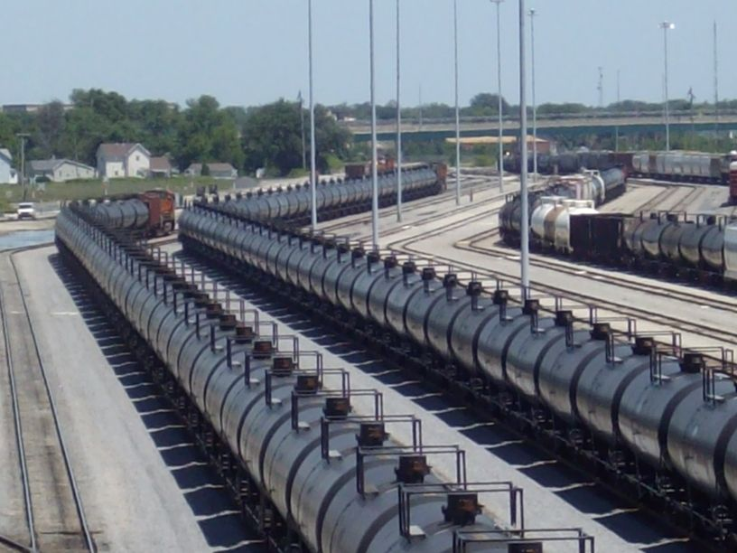
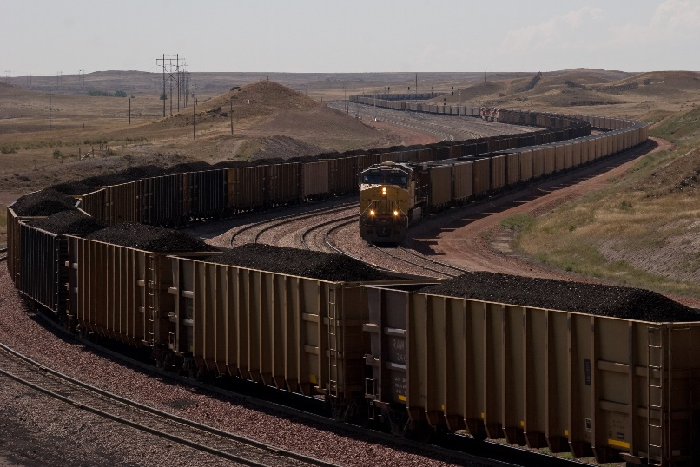
1a. Three Types of Modern Freight Trains
Unit Trains
Unit trains haul a single freight or commodity such as coal, automobiles, oil, or grain.
The use the same type of car to run between two points with no loading or unloading stops in between.
These trains usually deliver their freight to one destination, saving a lot of time because they don’t have to be sorted in a classification yard and redirected.

Slide 11
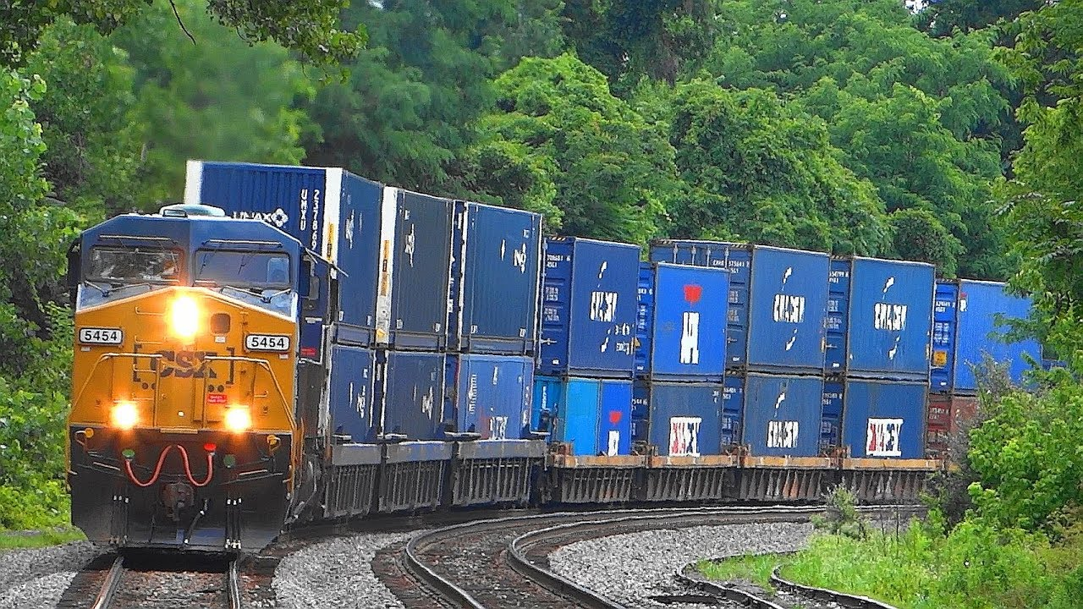
1a. Three Types of Modern Freight Trains
Intermodal Trains
These trains haul standardized, space-saving containers and trailers that are also carried on trucks and ships.
This method of shipping is called containerization.
It saves shippers considerable time and handling expense while protecting the cargo from the weather, damage, and theft.
Intermodal containers can move as singles loaded on flatcars, or as double-stacks with containers stacked two-high.

Slide 12

Requirement 1
Do THREE of the following:
  Name three types of modern freight trains. Explain why unit trains are more efficient than mixed freight trains.
  Name one Class I or regional railroad. Explain what major cities it serves, the locations of major terminals, service facilities, and crew change points, and the major commodities it carries.
  Using models or pictures, identify 10 types of railroad freight or passenger cars. Explain the purpose of each type of car.
  Explain how a modern diesel or electric locomotive develops power. Explain the terms dynamic braking and radial steering trucks.

Slide 13
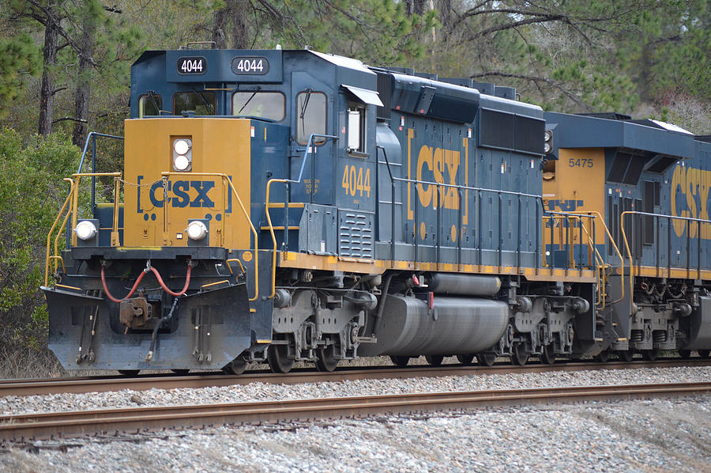
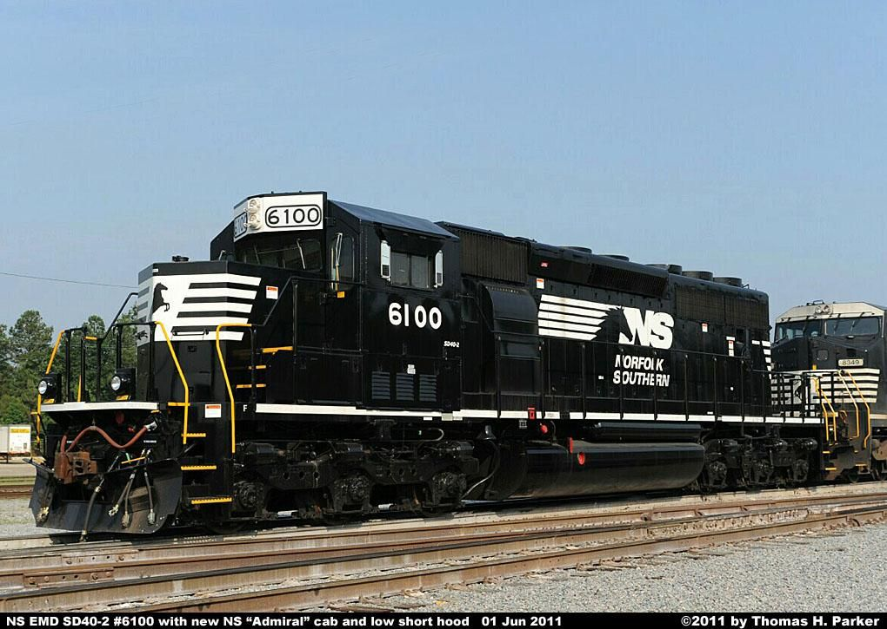
1b. Class 1 Railroads
The seven Class 1 railroads are BNSF Railway Co., CSX Transportation, Grand Trunk Corporation (Canadian National’s operations), Kansas City Southern Railway, Norfolk Southern, Soo Line Corporation (Canadian Pacific’s operations), and Union Pacific Railroad.
Click on the hyperlinks to find out what major cities they serve, the locations of their major terminals, service facilities, and crew change points, and the major commodities they carry.

Slide 14
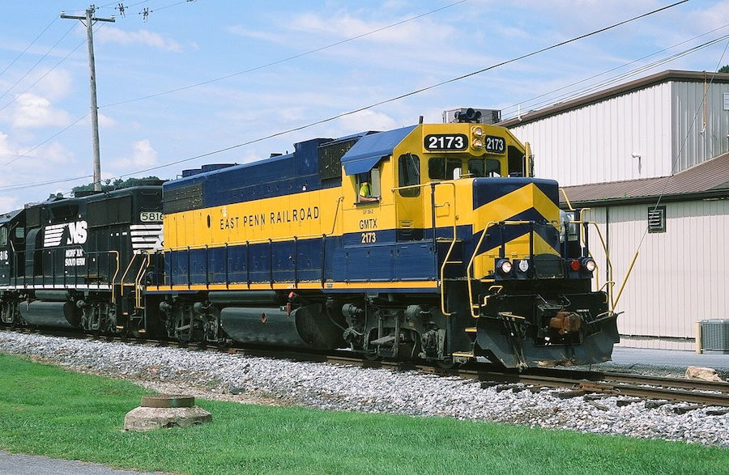
1b. Regional Railroads
In the United States, a regional railroad is a railroad company that is not Class I, but still has a substantial amount of traffic or trackage (and is thus not a short line).
Click on the hyperlink for information on Regional Railroads to learn what major cities they serve, the locations of major terminals, service facilities, and crew change points, and the major commodities it carries.

Slide 15
Requirement 1
Do THREE of the following:
  Name three types of modern freight trains. Explain why unit trains are more efficient than mixed freight trains.
  Name one Class I or regional railroad. Explain what major cities it serves, the locations of major terminals, service facilities, and crew change points, and the major commodities it carries.
  Using models or pictures, identify 10 types of railroad freight or passenger cars. Explain the purpose of each type of car.
  Explain how a modern diesel or electric locomotive develops power. Explain the terms dynamic braking and radial steering trucks.

Slide 16
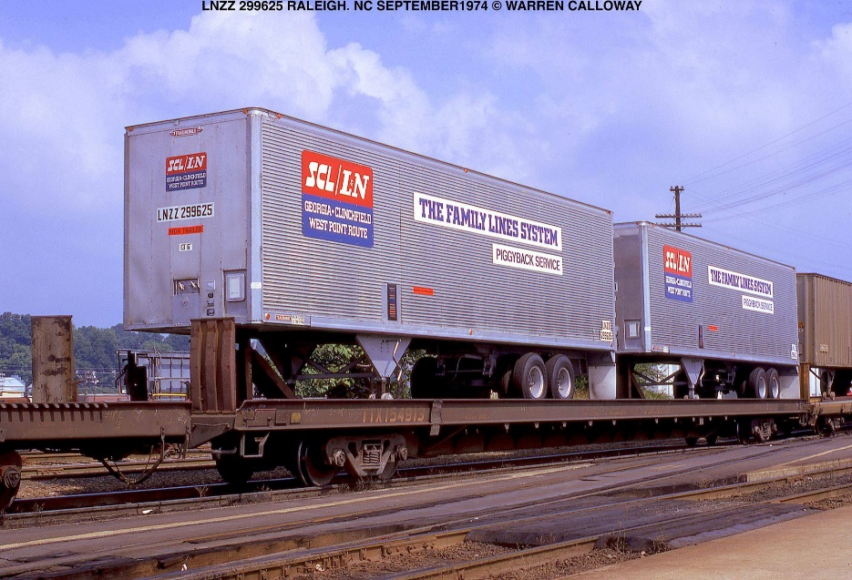
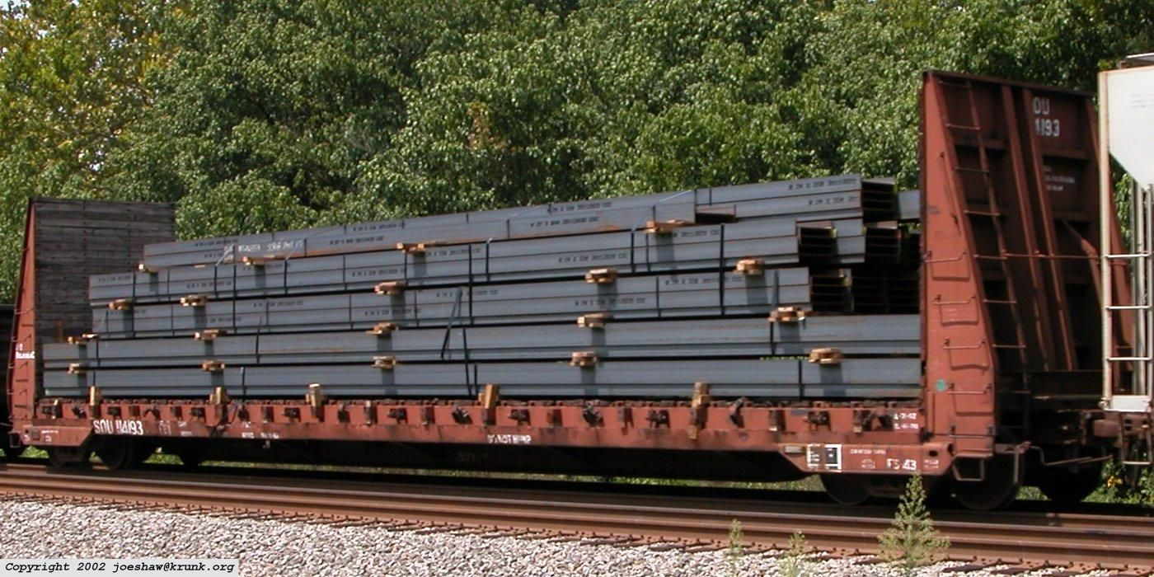
1c. Railcars
Flatcars are used for loads that are too large or cumbersome to load in enclosed cars such as boxcars.

Slide 17
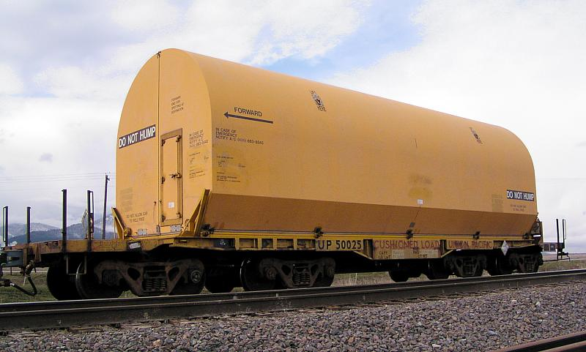
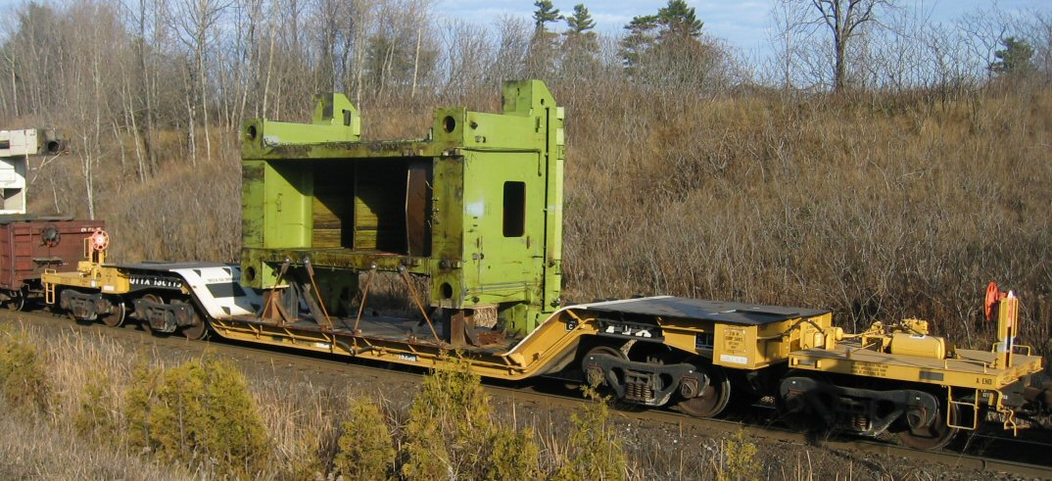
1c. Railcars
Heavy capacity flatcars were developed to move very heavy loads.
The extra wheels on each end of the car help to distribute the weight.
They may have a depressed center to handle excess-height loads.

Slide 18
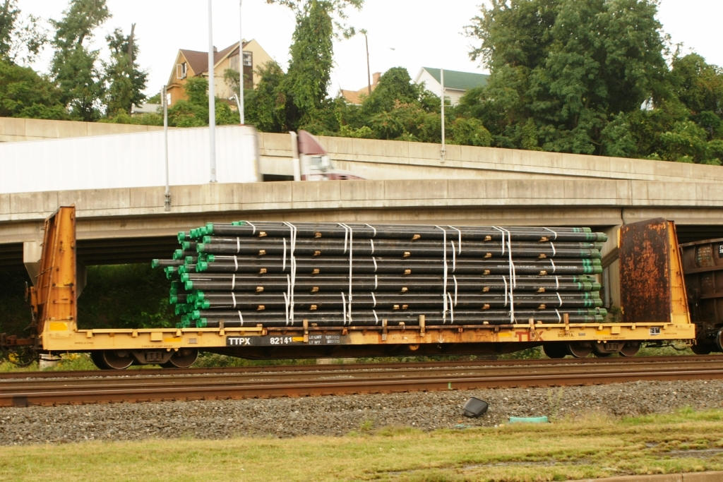
1c. Railcars
Bulkhead Flatcars are designed with sturdy end-walls (bulkheads) to prevent loads from shifting past the ends of the car.

Slide 19
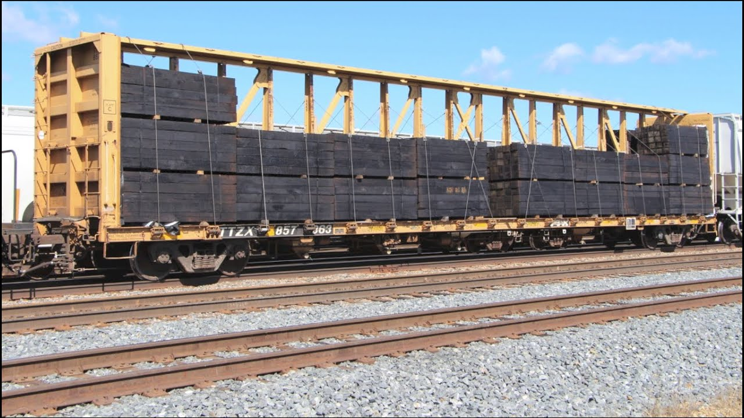
1c. Railcars
Center-Beam Flatcars were created to help keep loads from shifting from side to side, and are often used for shipping lumber.

Slide 20
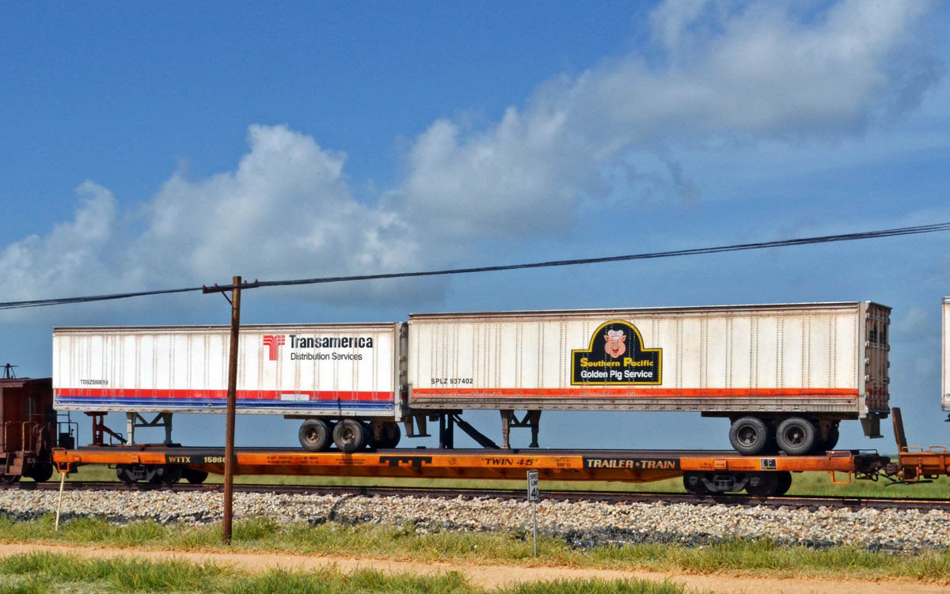
1c. Railcars
Trailer-on-Flatcar (TOFC) are flatcars designed to have a tractor trailer driven up a loading ramp onto the flatcar.
They have special supports for the front end of the trailer.

Slide 21
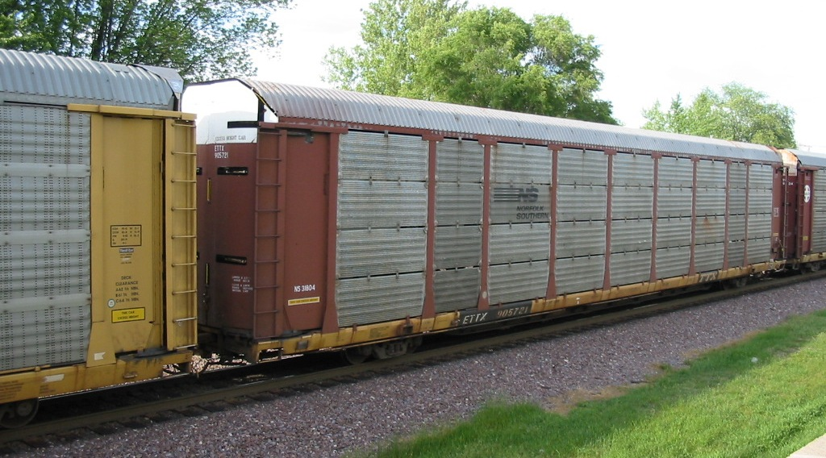
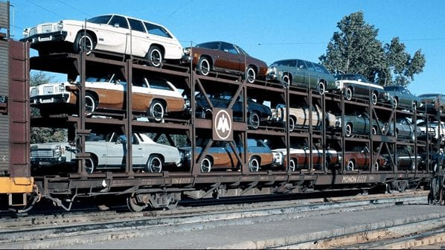
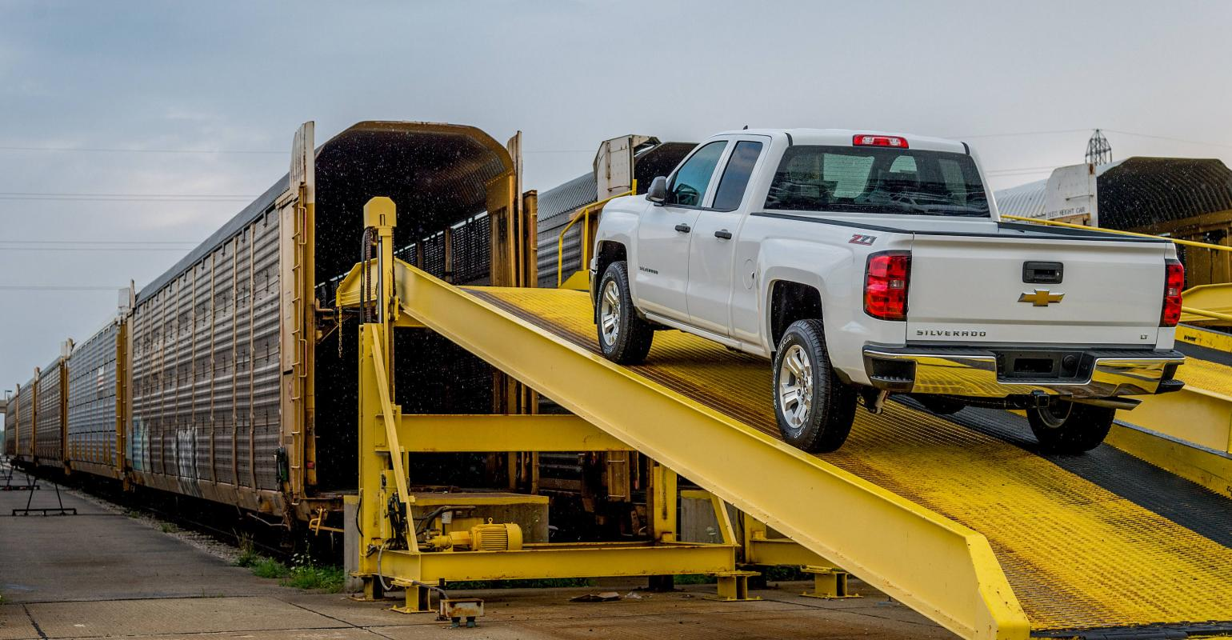
1c. Railcars
An autorack, also known as an auto carrier, is a specialized piece of railroad rolling stock used to transport automobiles and light trucks.

Slide 22
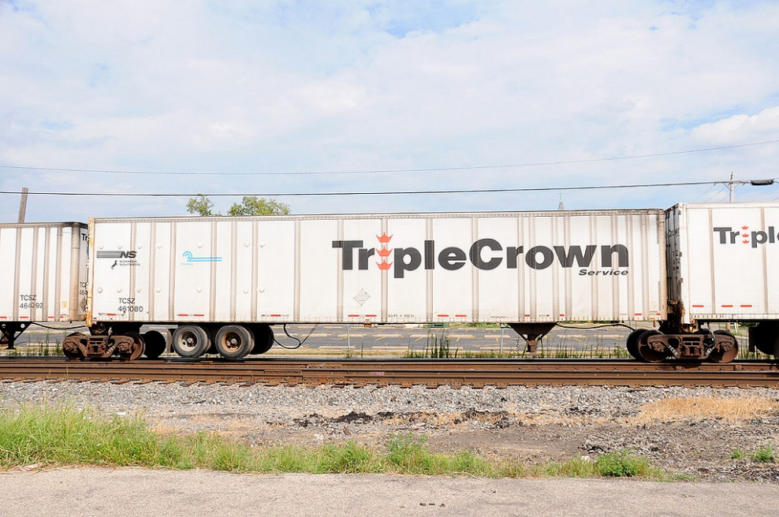
1c. Railcars
Road-Railer Trains are "Bi-Modal", meaning that the trailers can be used in two modes of service (road and rail).
These tractor trailers have special features that make it quick and easy to connect them to special train wheelsets and raise their road wheels.
At their rail destination, the road wheels are lowered, and another truck drives them to their final destination.

Slide 23
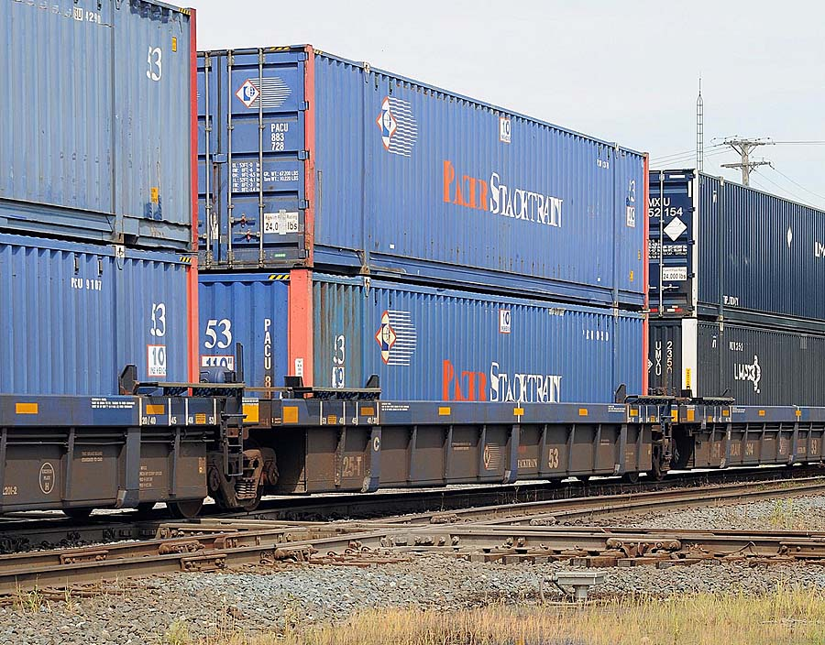
1c. Railcars
Intermodal Cars (also called Well Cars, or the trademarked name "Stack Trains") are meant to carry the standard-sized intermodal freight containers.
These containers can move from ships, to trailers, to trains using cranes at intermodal freight terminals.

Slide 24
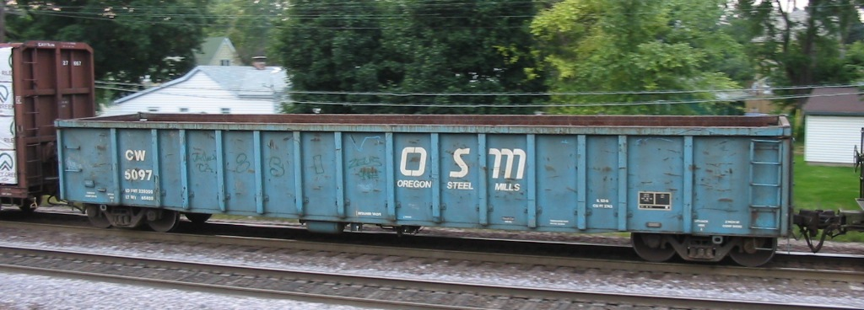
1c. Railcars
Gondolas are a flatcar with short or tall walls.
The walls keep the freight from shifting during transit, but don't protect it from the weather.
They are used to carry loads that can be loaded by dropping into the car, and can be unloaded by picking it up from above the car.

Slide 25
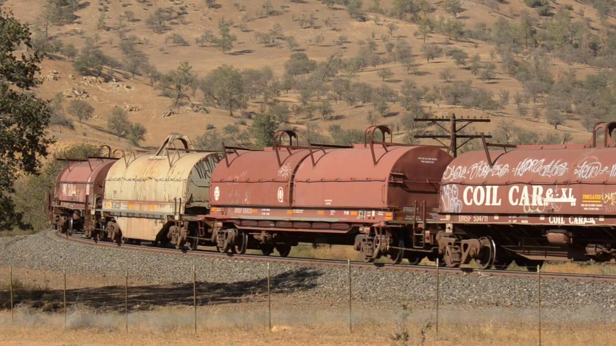
1c. Railcars
Coiled Steel cars are a variation of the gondola.
These cars have a cover that can be attached after the freight is loaded which provides protection in transit.
At the destination, the covers are lifted off, and the freight is removed using cranes.

Slide 26
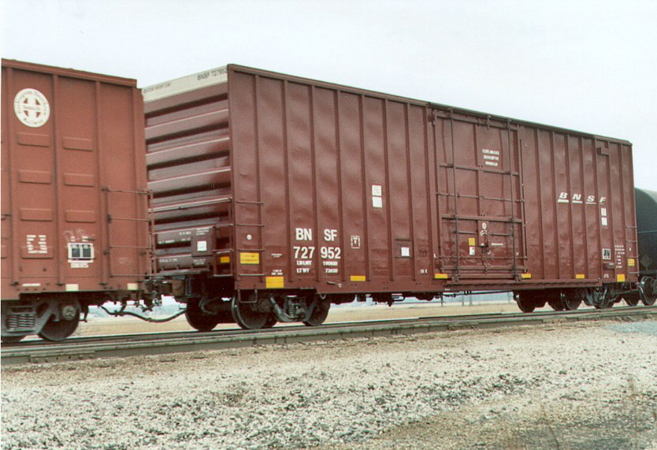
1c. Railcars
Boxcars were designed to cover freight that needed to be covered or secured while in transit.
They keep the sun off the freight, dry from the rain, and protect it from rocks and debris while on its trip.

Slide 27
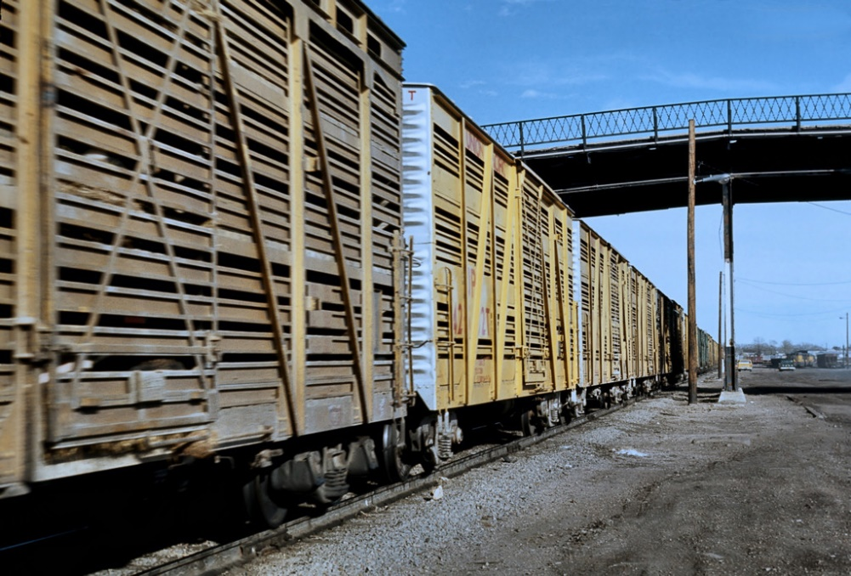
1c. Railcars
Livestock Cars are boxcars made to move livestock, most often cattle.
They have gaps between slats to allow good air circulation for the animals, while keeping them corralled during their trips.
Some cars have multiple levels, for carrying smaller animals.

Slide 28
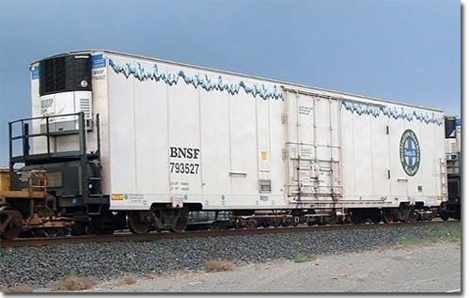
1c. Railcars
Refrigerated Boxcars are designed to get fresh produce to market across longer distances.
These modified boxcars have insulated floors, roof, and walls, to keep the sun and outside temperatures from affecting the freight.
Modern Refrigerated Boxcars have a refrigerator, similar to the one in your kitchen, with a generator and a fuel tank on each of these cars.

Slide 29
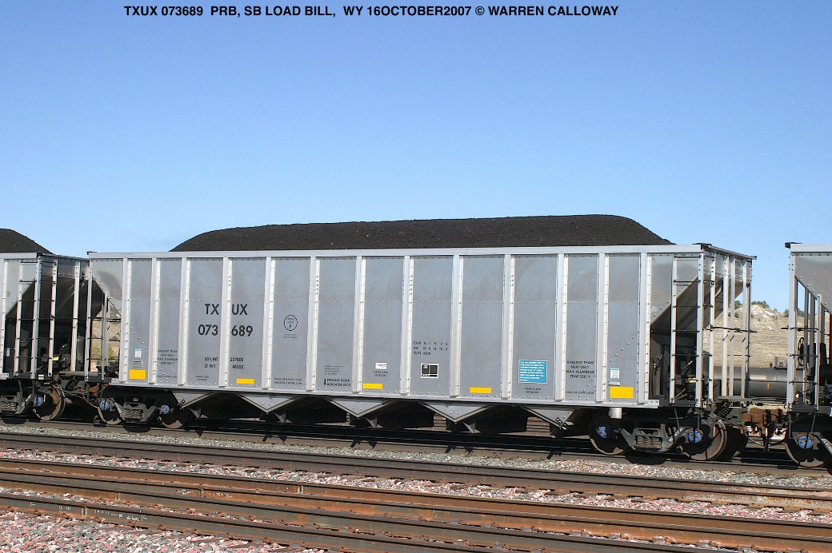
1c. Railcars
Hoppers look like a gondola with their tall sides,
These cars are meant to have freight (rocks, coal, etc.) dropped into the top, but are unloaded through the chutes at the bottom of the car.
These cars have steep, angular sides on the inside of the car, to help the freight move out when the discharge ports are opened.

Slide 30
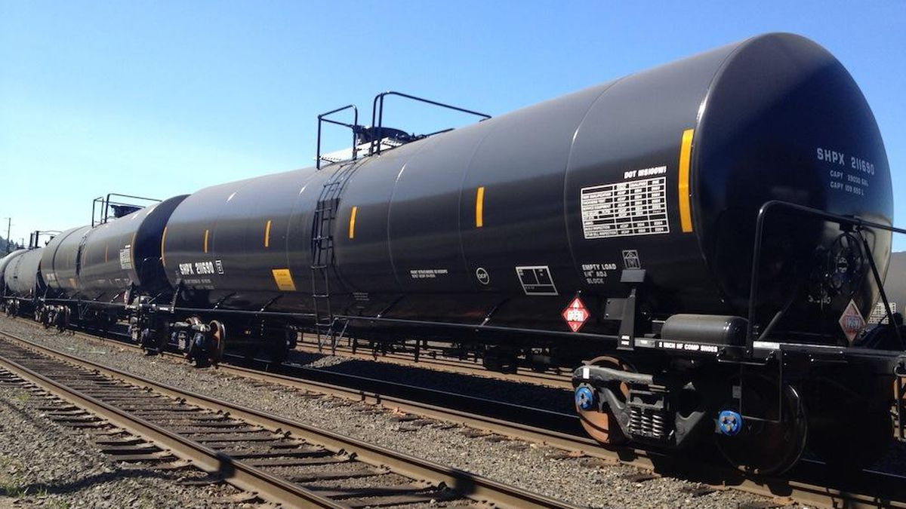
1c. Railcars
A tank car is a type of railroad car or rolling stock designed to transport liquid and gaseous commodities.

Slide 31
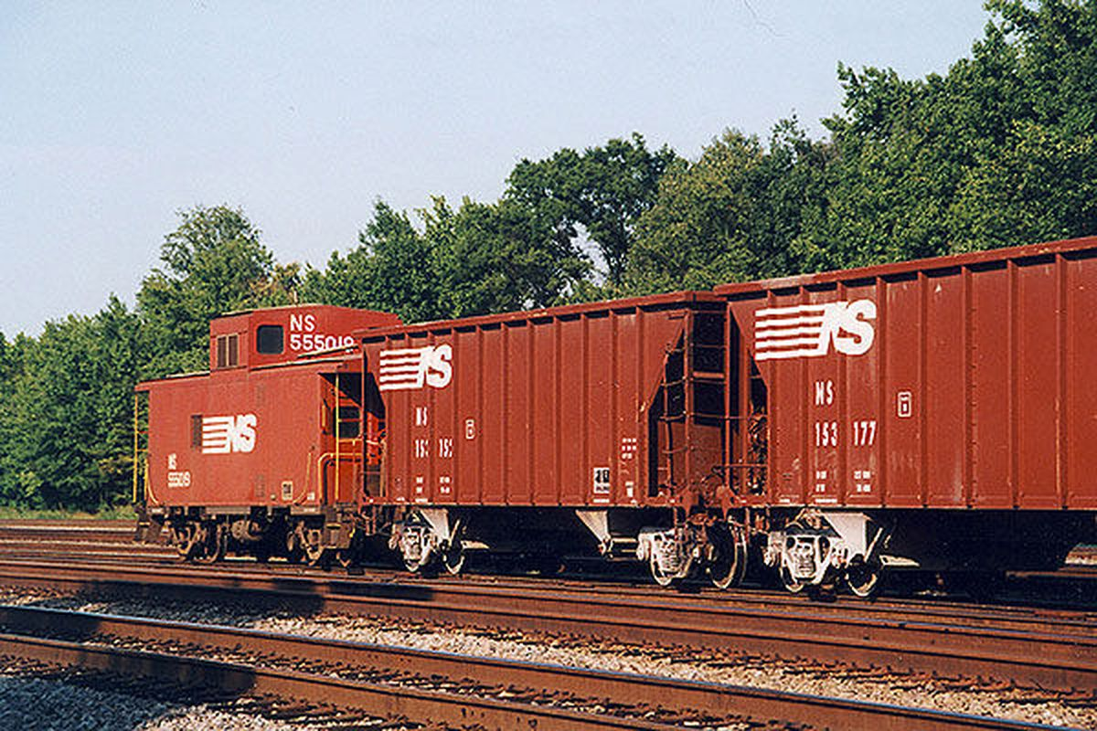
1c. Railcars
A caboose was a manned North American railroad car coupled at the end of a freight train.
Cabooses provided shelter for crew at the end of a train, who were formerly required in switching and shunting, keeping a lookout for load shifting, damage to equipment and cargo, and overheating axles.

Slide 32
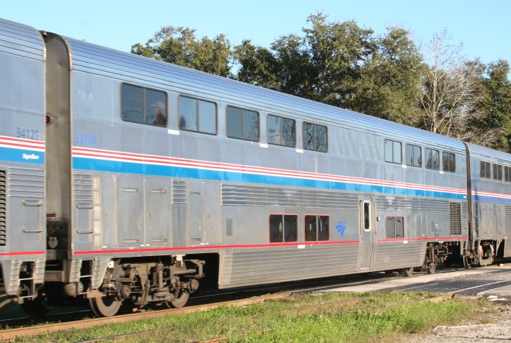
1c. Railcars
A passenger car is an item of railway rolling stock that is designed to carry passengers.
The term passenger car can also be associated with a sleeping car, a baggage car, a dining car, railway post office and prisoner transport cars.

Slide 33
Requirement 1
Do THREE of the following:
  Name three types of modern freight trains. Explain why unit trains are more efficient than mixed freight trains.
  Name one Class I or regional railroad. Explain what major cities it serves, the locations of major terminals, service facilities, and crew change points, and the major commodities it carries.
  Using models or pictures, identify 10 types of railroad freight or passenger cars. Explain the purpose of each type of car.
  Explain how a modern diesel or electric locomotive develops power. Explain the terms dynamic braking and radial steering trucks.

Slide 34
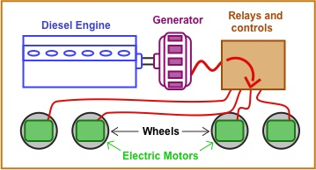
1d. Train Power
A diesel-electric locomotive, the most common locomotive in service today, has a main diesel engine, which runs a large generator.
The generator produces electricity to power the electric traction motors, which are mounted – one per axle – on the power trucks.

Slide 35
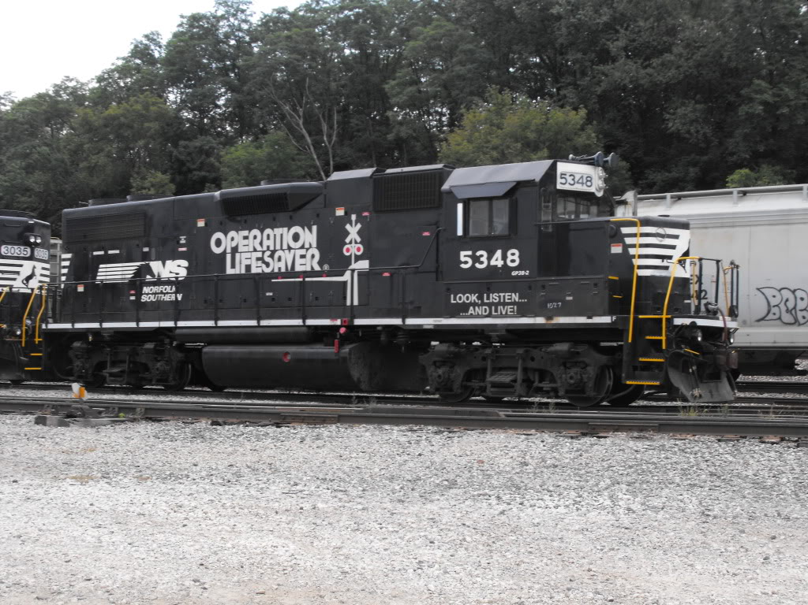
1d. Dynamic Braking
A train typically stops by using an air brake system, which allows the engineer to apply the brakes to all cars at once by forcing the brake shoes against the wheel rims with air pressure.
On locomotives with electric drive motors, an electromagnetic system allows the motors to act as temporary generators during deceleration.
The electrical current produced during braking is directed to large resistors, converted to heat, and then released into the atmosphere.
This is known as Dynamic Braking.
By doing this, the motors are harder to turn, which effectively slows the train down without using the air brakes saving wear and tear on the brake shoes and wheel rims.
Cooling Grill for Brake Resistors

Slide 36
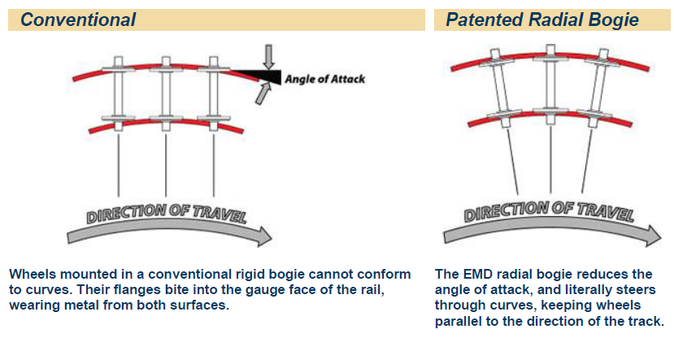
1d. Radial Steering Trucks
A locomotive’s “trucks” are the complete assemblies of driving wheels, axles, gearboxes, brakes, coil springs, and other parts – mounted in a frame.
Radial steering trucks are hinged to flex and steer the wheels smoothly through curves.
These trucks reduce wheel and track wear and provide better adhesion.

Slide 37
Requirement 2
Do the following:
  Explain the purpose and formation of Amtrak. Explain, by the use of a timetable, a plan for making a trip by rail between two cities at least 500 miles apart. List the times of departure and arrival at your destination, the train number, and the type of service you want.
  List and explain the various forms of public/mass transit using rail.

Slide 38
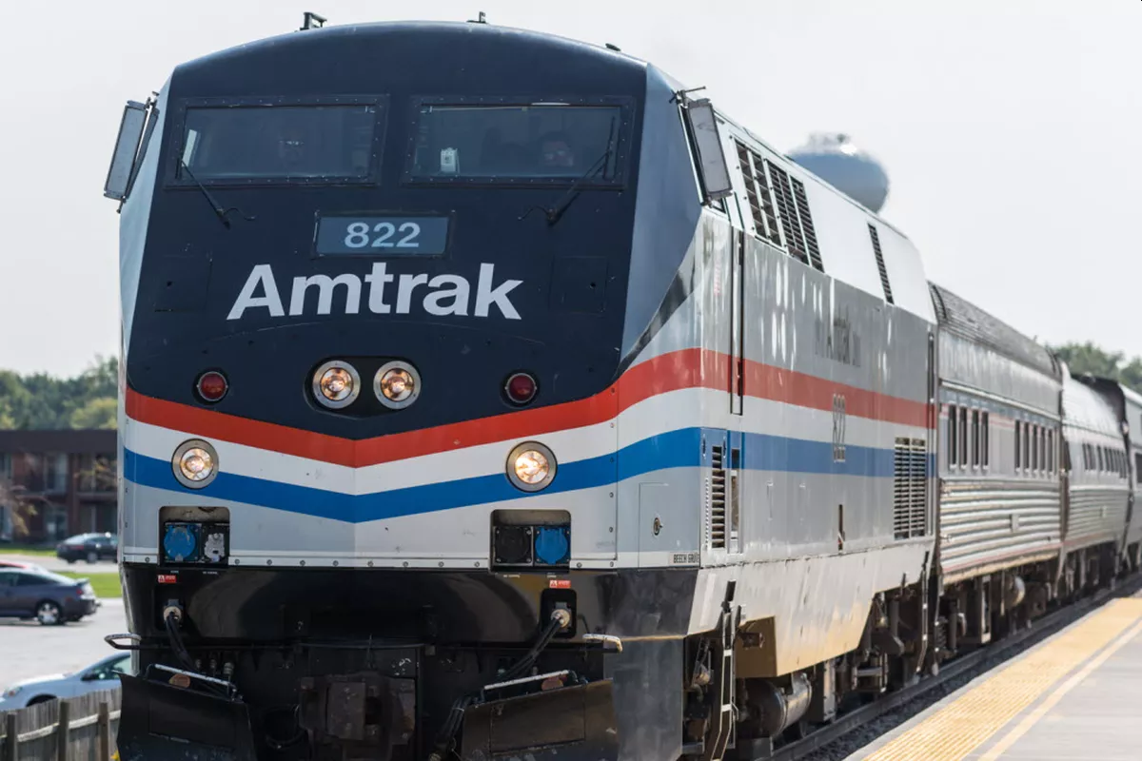
Amtrak
America’s Passenger Rail Service
In 1971, the U.S. Congress created the National Railroad Passenger Corporation known as Amtrak.
It’s purpose was to take over and operate the nation’s intercity passenger rail service to relieve the nation’s private railroads of all passenger service, which had become unprofitable because of competition from automobiles and airplanes.
In 2018, Amtrak served 31.7 million passengers a year over 21,400 miles of track, almost all of it owned by the Class I freight railroads.
The exception is the Northeast Corridor where Amtrak owns and maintains most of the high speed electrified rail line between Boston, MA and Washington, D.C.

Slide 39
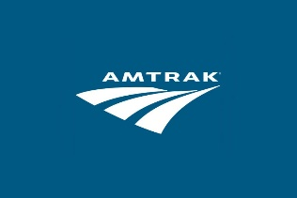
Plan a 500 mile trip by train
Use the Amtrak website by clicking on the Amtrak icon to plan your trip.
You do NOT have to buy tickets. Remember what you need to list for this part;
  Departure City:
  Destination City:
  (The two cities must be more than 500 miles apart.)
  Departure date and time:
  Arrival date and time:
  Train Number(s):
  (If you connect with other trains or buses, make a note about them.)
  Any services you would order, besides basic seating:
Remember, this can be a dream trip, where money isn't an obstacle. Think about the amount of time that you will be on the train. If the trip takes more than a day, you may want to arrange for sleeping accommodations. (What are your choices? What are the costs?) You may also want to arrange for meals on the train. (Will you pack food that will last without refrigeration, or will you pay for food on the train? What options are offered?)

Slide 40
Requirement 2
Do the following:
  Explain the purpose and formation of Amtrak. Explain, by the use of a timetable, a plan for making a trip by rail between two cities at least 500 miles apart. List the times of departure and arrival at your destination, the train number, and the type of service you want.
  List and explain the various forms of public/mass transit using rail.

Slide 41
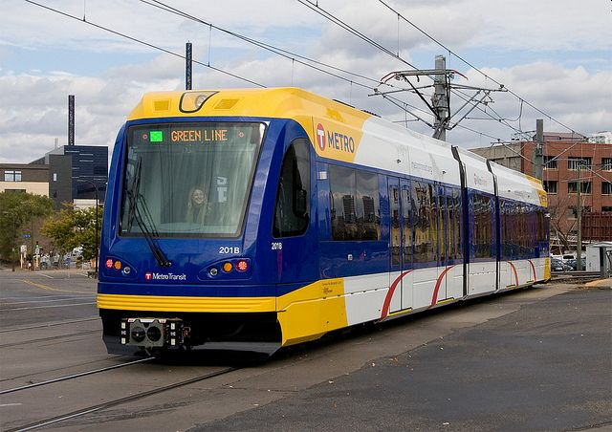
Public/Mass Transit Using Rail
Light Rail trains usually use overhead electric power, electric motors under each coach, and using a rail gauge slightly different from standard trains.
They normally operate away from regular train lines, and closer to metropolitan and urban population centers.

Slide 42
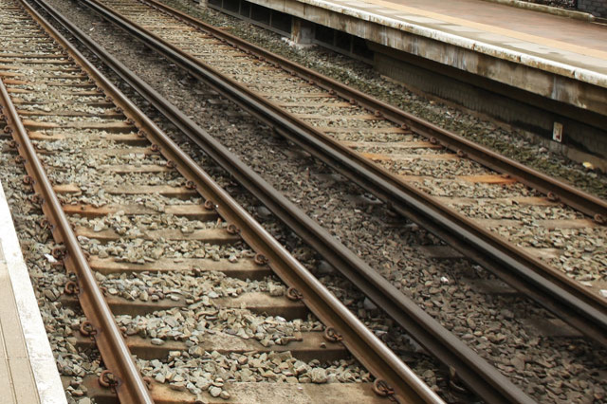
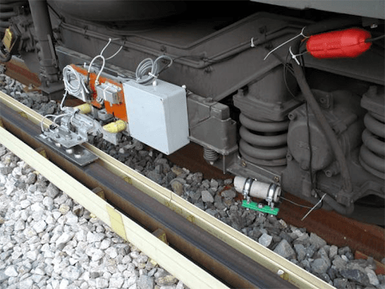
Public/Mass Transit Using Rail
A third rail, also known as a live rail, electric rail or conductor rail, is a method of providing electric power to a railway locomotive or train, through a semi-continuous rigid conductor placed alongside or between the rails of a railway track.
Third-Rail Trains have power pick-ups below the train body.
It is used typically in a mass transit or rapid transit system.

Slide 43
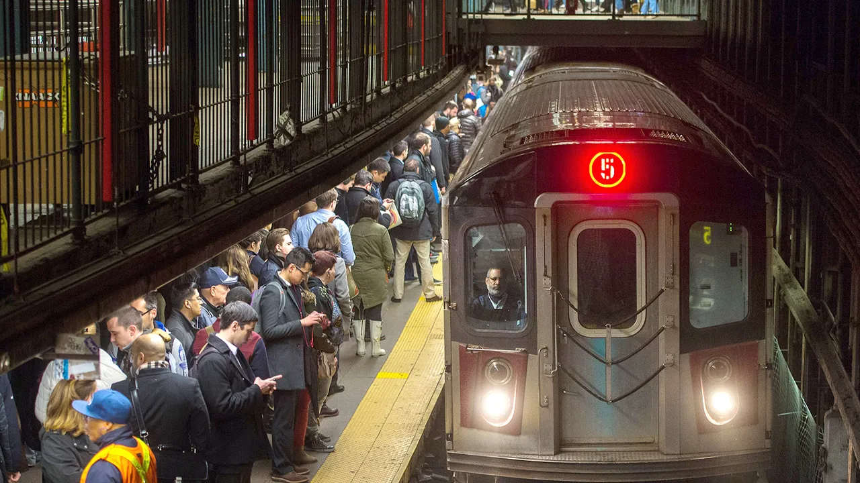
Public/Mass Transit Using Rail
Subway trains are an underground railway system used to transport large numbers of passengers within urban and suburban areas.
Subways are usually built under city streets.
Underground operation helps these trains run reliably during bad weather conditions.

Slide 44
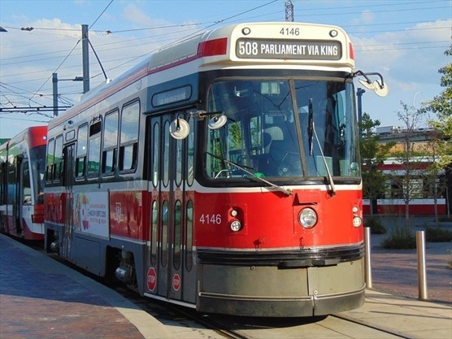
Public/Mass Transit Using Rail
Streetcars or Trolley Cars were once the chief mode of public transit in hundreds of North American cities and towns.
They use overhead electrical pickups and rails as a fixed path.
In many areas they have been replaced by Trolley Buses which use the overhead wires and electric motors but the buses ride on rubber tires so that the bus can move through traffic more easily.

Slide 45
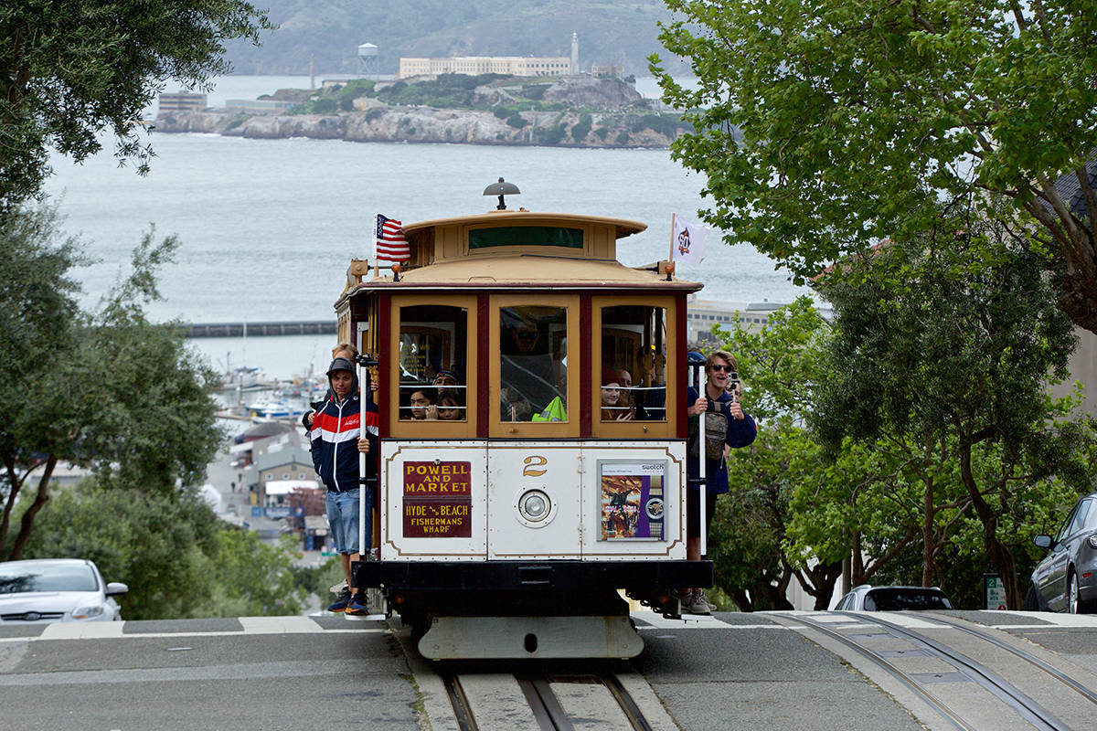
Public/Mass Transit Using Rail
San Francisco Cable Cars are pulled by a cable running below the street, held by a grip that extends from the car through a slit in the street surface, between the rails.
The Gripman uses a device to grab the moving cable under the street to pull the car up and down the hills, and he uses brakes on the car to slow and stop the car.

Slide 46
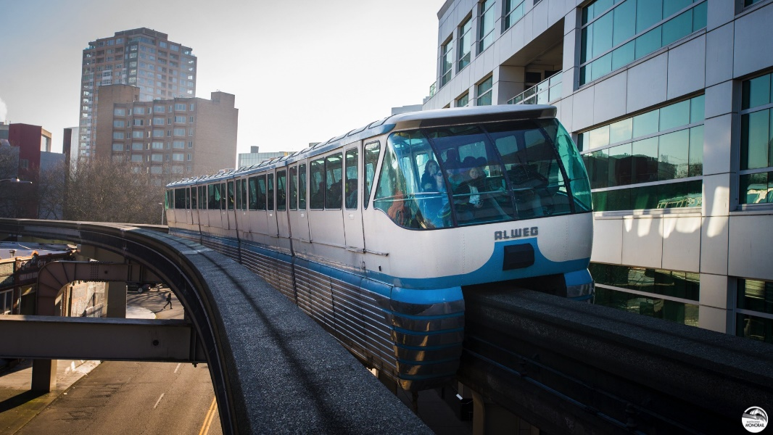
Public/Mass Transit Using Rail
A monorail is a railway system in which the track consists of a single rail.
Many monorail systems run on elevated tracks through crowded areas that would otherwise require the construction of expensive underground lines or have the disadvantages of surface lines.

Slide 47
Requirement 3
Do ONE of the following:
  Name four departments of a railroad company. Describe what each department does.
  Tell about the opportunities in railroading that interest you most and why.
  Name four rail support industries, Describe the function of each one.
  With your parent's and counselor's approval, interview someone employed in the rail industry. Learn what that person does and how this person became interested in railroading. Find out what type of schooling and training are required for this position.

Slide 48
Departments of a Railroad
  Executive and Management – Run the various departments. Executives who work within these departments must make sure all functional areas are run effectively.
  Operations – manages the trains, other rolling stock, and roadbed.
  Transportation – schedules trains.
  Mechanical – repairs and inspections.
  Engineering – planning layout of tracks and other facilities, and signaling.
  Sales – market and sell the railroad’s services
  Legal – handles all legal matters.
  Finance – track revenue and expenses and the purchase of needed supplies and equipment.
  Human Resources – handles employment and benefits.
  Public Relations – Inform the public, prospective customers, investors, partners, employees, and other stakeholders, and ultimately persuade them to maintain a positive or favorable view about the organization.

Slide 49
Requirement 3
Do ONE of the following:
  Name four departments of a railroad company. Describe what each department does.
  Tell about the opportunities in railroading that interest you most and why.
  Name four rail support industries, Describe the function of each one.
  With your parent's and counselor's approval, interview someone employed in the rail industry. Learn what that person does and how this person became interested in railroading. Find out what type of schooling and training are required for this position.

Slide 50
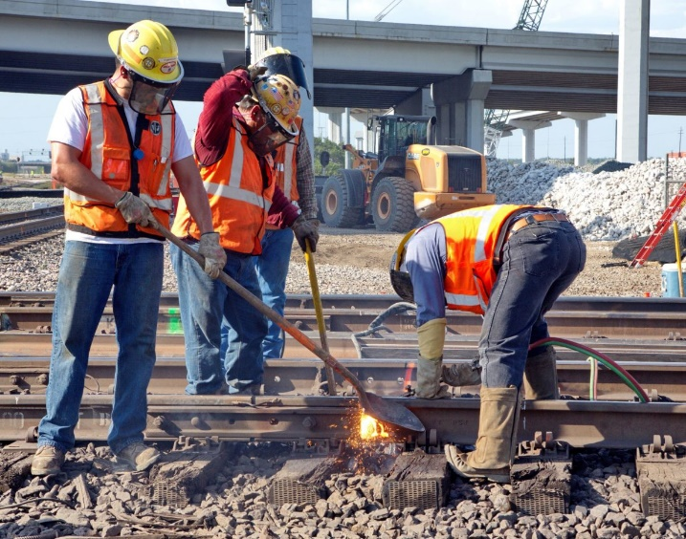
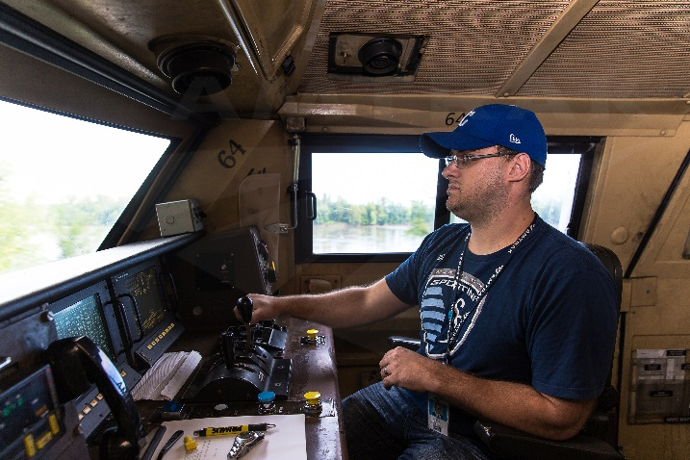
Opportunities in Railroading
The railroads have many different jobs, and different departments which include:
  Operating the trains (the on-train crew)
  Servicing, repairing and rebuilding trains
  Building track, structures (buildings and bridges), power and signaling.
For this requirement, you should think about what you would like to do, and look at some of the jobs that the railroads have available. Pick your favorite job, and tell why you would like to do that job.
Railroad Job Links:
  Union Pacific
  Canadian National
  CSX
  Canadian Pacific
  Burlington Northern / Santa Fe
  Amtrak

Slide 51
Requirement 3
Do ONE of the following:
  Name four departments of a railroad company. Describe what each department does.
  Tell about the opportunities in railroading that interest you most and why.
  Name four rail support industries, Describe the function of each one.
  With your parent's and counselor's approval, interview someone employed in the rail industry. Learn what that person does and how this person became interested in railroading. Find out what type of schooling and training are required for this position.

Slide 52
Rail Support Industries
The Herzog Companies provide temporary services that can help supplement the workforce of a railroad.
LORAM makes special equipment for railroads
Railworks specializes in track building, in North America. This includes restoration of existing tracks, installing new tracks, and even things that connect to the track, like the signaling systems.
H & H Engineering provides track building, inspection services, and track rehabilitation services in the Western U.S.
TTX has been supplying a collection of freight cars to it's member/owner railroads, so that the railroads do not need to purchase large groups of cars that might not always be used.
FreightCar America designs special heavy-duty (50-year service life) freight cars.
Balfour Beatty Rail provide track and signal construction and provide expertise in electrified train systems.
(GEISMAR) Modern Track Machinery makes specialized equipment that makes it fast, easy, and consistent to install track and overhead lines.

Slide 53
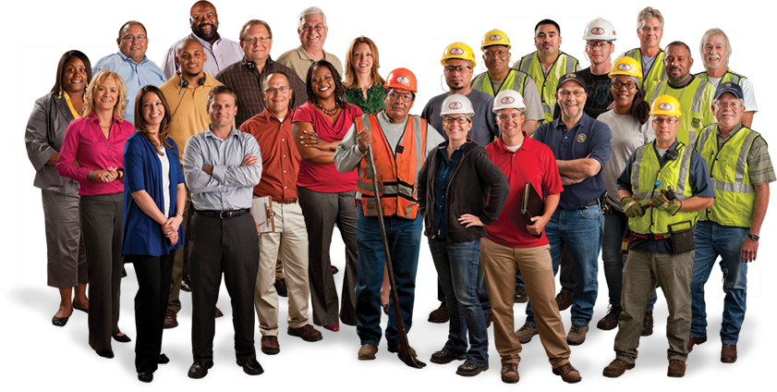
Requirement 3
Do ONE of the following:
  Name four departments of a railroad company. Describe what each department does.
  Tell about the opportunities in railroading that interest you most and why.
  Name four rail support industries, Describe the function of each one.
  With your parent's and counselor's approval, interview someone employed in the rail industry. Learn what that person does and how this person became interested in railroading. Find out what type of schooling and training are required for this position.

Slide 54
Requirement 4
Explain the purpose of Operation Lifesaver and its mission.

Slide 55

Operation Lifesaver
Operation Lifesaver is a non-profit organization that provides public education programs in states across the U.S. to prevent collisions, injuries, and fatalities on and around railroad tracks and highway-rail grade crossings.

Slide 56
Requirement 5
Do THREE of the following:
  List five safety precautions that help make trains safer for workers and passengers.
  Explain to your merit badge counselor why safety around rights-of-way is important.
  List 10 safety tips to remember when you are near a railroad track (either on the ground or on a station platform) or aboard a train.
  Tell your counselor about the guidelines for conduct that should be followed when you are near or on railroad property. Explain the dangers of trespassing on railroad property.
  Tell what an automobile driver can do to safely operate a car at grade crossings, and list three things an automobile driver should never do at a grade crossing.
  Tell how to report a malfunction of grade crossing warning devices.
  List safety precautions a pedestrian should follow at a public crossing.

Slide 57
Safety Precautions
Stay Alert: Trains can come from either direction at any time and can be very quiet. Around train tracks or in stations, obey all warning signs and signals and use caution when using headsets or cell phones.
Watch the Overhang: Trains are wider than the tracks; never sit on the edge of a station platform.
Stand Away from the Platform Edge: Pay attention to painted or raised markings at the platform edge, and stay at least three feet from the train while it is coming in or out of the station.
When On Board, Hold On: Hold on tight to poles or seats, and listen carefully to directions from the train operator or conductor.
Watch Your Step: Be careful getting on and off the train - there may be a gap between the train and platform or steps.
Don't Take Shortcuts with Your Life: Follow directional signs and markings that let you know where it is safe to cross the tracks. Crossing the tracks anywhere else is dangerous and illegal.

Slide 58
Requirement 5
Do THREE of the following:
  List five safety precautions that help make trains safer for workers and passengers.
  Explain to your merit badge counselor why safety around rights-of-way is important.
  List 10 safety tips to remember when you are near a railroad track (either on the ground or on a station platform) or aboard a train.
  Tell your counselor about the guidelines for conduct that should be followed when you are near or on railroad property. Explain the dangers of trespassing on railroad property.
  Tell what an automobile driver can do to safely operate a car at grade crossings, and list three things an automobile driver should never do at a grade crossing.
  Tell how to report a malfunction of grade crossing warning devices.
  List safety precautions a pedestrian should follow at a public crossing.

Slide 59
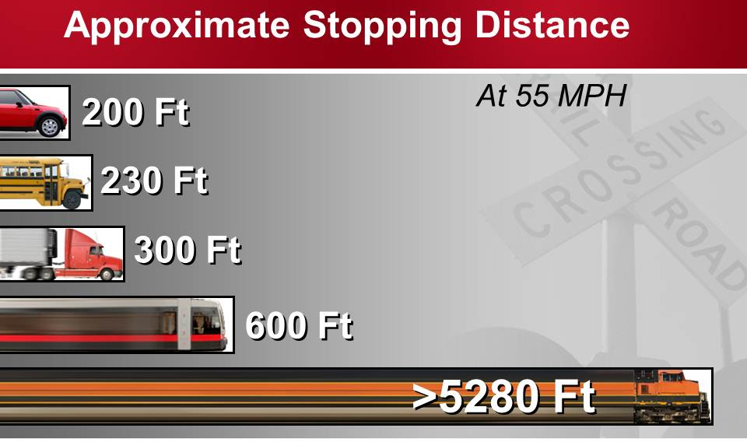
Train Track Safety Basics
All train tracks are private property. Never walk on tracks; it's illegal trespass and highly dangerous. It takes the average freight train traveling at 55 mph more than a mile to stop making it impossible to avoid a collision.
Freight trains don't travel at fixed times. Always expect a train at each highway-rail intersection at any time.
A train can extend three feet or more beyond the steel rail, putting the safety zone for pedestrians well beyond the three foot mark.
Today's trains are quieter than ever, producing no telltale "clackety-clack." Any approaching train is always closer and moving faster, than you think.

Slide 60
Requirement 5
Do THREE of the following:
  List five safety precautions that help make trains safer for workers and passengers.
  Explain to your merit badge counselor why safety around rights-of-way is important.
  List 10 safety tips to remember when you are near a railroad track (either on the ground or on a station platform) or aboard a train.
  Tell your counselor about the guidelines for conduct that should be followed when you are near or on railroad property. Explain the dangers of trespassing on railroad property.
  Tell what an automobile driver can do to safely operate a car at grade crossings, and list three things an automobile driver should never do at a grade crossing.
  Tell how to report a malfunction of grade crossing warning devices.
  List safety precautions a pedestrian should follow at a public crossing.

Slide 61
Safety Tips
Don’t play near trains or tracks; pushing and shoving can cause accidents.
Remember to obey all warning signs and signals.
Never cross train tracks to get to a platform. Use marked pathways and stairways to get from platform to platform.
Don’t ever try to “beat” a train. An approaching train is closer and moving faster than you think. Don’t assume the operator sees you and do not step in front of a train for any reason.
Always stay behind the yellow lines at train stations. Enter or exit a station platform at designated areas.
Use care when climbing the steps to your rail car. Hold onto the railing and pay attention to where you walk.
If you need to move between cars, be aware that gaps may present a trip hazard.
When boarding train, familiarize yourself with the safety information and emergency procedures on the safety card found in most seat backs.
Once the train begins to move, keep one hand on a railing or seat back as you walk through the rail cars. It is very easy to lose your balance on a moving train.
Never attempt to board or exit a moving train.

Slide 62
Requirement 5
Do THREE of the following:
  List five safety precautions that help make trains safer for workers and passengers.
  Explain to your merit badge counselor why safety around rights-of-way is important.
  List 10 safety tips to remember when you are near a railroad track (either on the ground or on a station platform) or aboard a train.
  Tell your counselor about the guidelines for conduct that should be followed when you are near or on railroad property. Explain the dangers of trespassing on railroad property.
  Tell what an automobile driver can do to safely operate a car at grade crossings, and list three things an automobile driver should never do at a grade crossing.
  Tell how to report a malfunction of grade crossing warning devices.
  List safety precautions a pedestrian should follow at a public crossing.

Slide 63
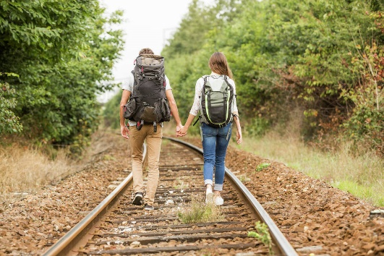
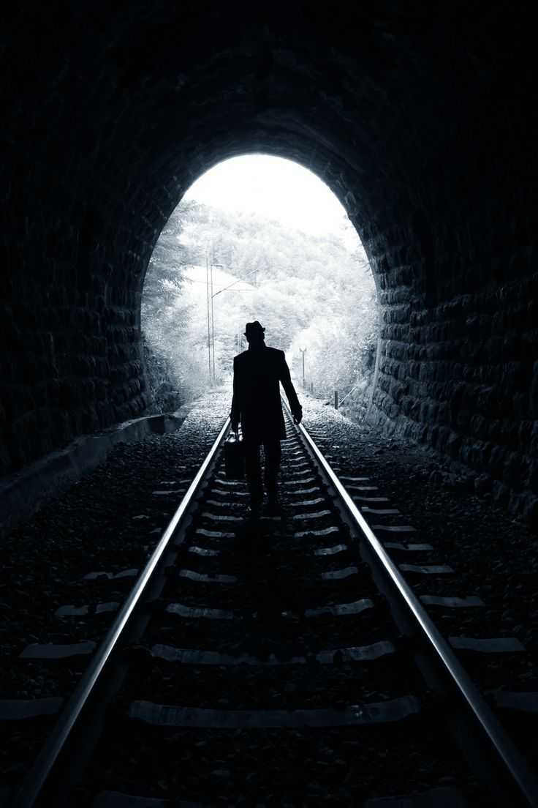
Conduct Near or On Railroad Property
Avoid walking along tracks, especially while wearing earphones.
Avoid fishing or diving from a railroad bridge or trestle.
Take an alternate route instead of walking through tunnels, which allow very little clearance.
Resist the temptation to place items on tracks – even coins to be flattened.
Leave railroad switches alone.
Stay away from rolling stock such as sidelined cars, track maintenance equipment, piles of ties, ballast, or stacked rail.

Slide 64
Requirement 5
Do THREE of the following:
  List five safety precautions that help make trains safer for workers and passengers.
  Explain to your merit badge counselor why safety around rights-of-way is important.
  List 10 safety tips to remember when you are near a railroad track (either on the ground or on a station platform) or aboard a train.
  Tell your counselor about the guidelines for conduct that should be followed when you are near or on railroad property. Explain the dangers of trespassing on railroad property.
  Tell what an automobile driver can do to safely operate a car at grade crossings, and list three things an automobile driver should never do at a grade crossing.
  Tell how to report a malfunction of grade crossing warning devices.
  List safety precautions a pedestrian should follow at a public crossing.

Slide 65
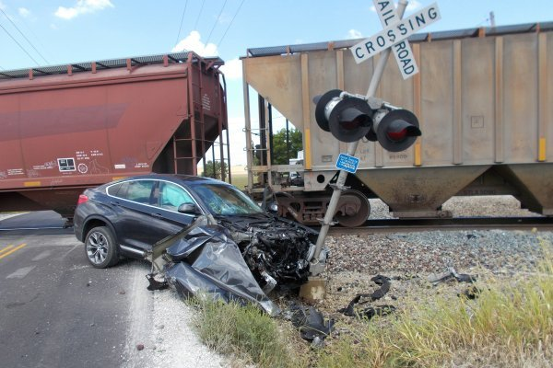
Automobiles and Grade Crossings
Trains have the right of way 100% of the time over emergency vehicles, cars, the police and pedestrians.
  The average locomotive weighs about 400,000 pounds or 200 tons; it can weigh up to 6,000 tons. This makes the weight ratio of a car to a train proportional to that of a soda can to a car. We all know what happens to a soda can hit by a car.
Never race a train to the crossing. If you tie, you lose.
Never drive around lowered gates.
Never stop a vehicle on the tracks.
Never assume that a passing train is the only train on a multiple-track crossing.
Never cross the tracks anywhere but at the public grade crossing.

Slide 66
Requirement 5
Do THREE of the following:
  List five safety precautions that help make trains safer for workers and passengers.
  Explain to your merit badge counselor why safety around rights-of-way is important.
  List 10 safety tips to remember when you are near a railroad track (either on the ground or on a station platform) or aboard a train.
  Tell your counselor about the guidelines for conduct that should be followed when you are near or on railroad property. Explain the dangers of trespassing on railroad property.
  Tell what an automobile driver can do to safely operate a car at grade crossings, and list three things an automobile driver should never do at a grade crossing.
  Tell how to report a malfunction of grade crossing warning devices.
  List safety precautions a pedestrian should follow at a public crossing.

Slide 67
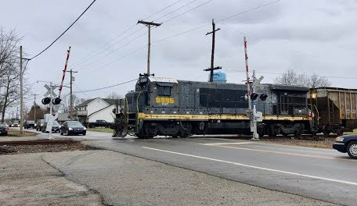
Defective Grade Crossing Devices
If you think that highway-rail grade crossing signals are not working, immediately call 9-1-1 and report the problem and location.
Then contact the railroad at the toll-free number posted on the signal building or cabinet at the crossing.
Inoperable Gates and Lights

Slide 68
Requirement 5
Do THREE of the following:
  List five safety precautions that help make trains safer for workers and passengers.
  Explain to your merit badge counselor why safety around rights-of-way is important.
  List 10 safety tips to remember when you are near a railroad track (either on the ground or on a station platform) or aboard a train.
  Tell your counselor about the guidelines for conduct that should be followed when you are near or on railroad property. Explain the dangers of trespassing on railroad property.
  Tell what an automobile driver can do to safely operate a car at grade crossings, and list three things an automobile driver should never do at a grade crossing.
  Tell how to report a malfunction of grade crossing warning devices.
  List safety precautions a pedestrian should follow at a public crossing.

Slide 69
Safety Precautions for Pedestrians
The only safe place to cross is at a designated public crossing
Railroad tracks, trestles, yards and equipment are private property and trespassers are subject to arrest and fine. You could be injured or killed in a busy rail yard.
Trains overhang the tracks by at least three feet in both directions; loose straps hanging from rail cars may extend even further. If you are in the right-of-way next to the tracks, you can be hit by the train.
Do not cross the tracks immediately after a train passes. A second train might be blocked by the first. Wait until you can see clearly around the first train in both directions.
Flashing red lights indicate a train is approaching. Never walk around or behind lowered gates at a crossing, and DO NOT cross the tracks until the lights have stopped flashing and it's safe to do so.
Do not hunt, fish or bungee jump from railroad trestles. There is only enough clearance on the tracks for a train to pass.
Do not attempt to hop aboard railroad equipment at any time. A slip of the foot can cost you a limb or your life.
Be aware trains do not follow set schedules. Any Time is Train Time!

Slide 70
Requirement 6
Explain the appearance and meaning of the following warning signs and devices: advance warning sign, pavement markings, crossbucks, flashing red lights, crossing gates.

Slide 71

Railroad Warning Signs
When approaching a public highway-rail crossing, drivers will see the round, yellow advance warning sign.

Slide 72

Railroad Warning Signs
Pavement markings are the same as the advance warning sign, but the letters are painted on the road surface and generally start at the advance warning sign and end with a stop bar near the crossing.

Slide 73

Railroad Warning Signs
The common crossbuck is the basic warning sign required at all public crossings.
It has the same meaning as a yield sign.
A smaller sign below the crossbuck indicates multiple sets of tracks.

Slide 74

Railroad Warning Signs
Busier railroad crossings require active warning devices such as a crossbuck with alternating flashing red lights to warn of the immediate approach of a train.
If the red lights are flashing at a railroad crossing all vehicles are required to stop even if a train is not in sight.

Slide 75

Railroad Warning Signs
At many crossings, there will be a crossing gate added to the signal.
The gates will be fully lowered 15 to 20 seconds before the train arrives.
The gates will rise and the signals will shut off once the end of the train clears the island circuit.
It is illegal to drive past a lowered crossing gate.

Slide 76
Requirement 7
Do EACH of the following:
  Explain how railroad signals operate and show two basic signal types using color and configuration.
  Explain the meaning of three horn signals.
  Describe a way to signal a train for an emergency stop.
  Explain the use and function of the EOTD (end-of-train device) or FRED (Flashing rear end device) used on the last car of most freight trains.

Slide 77

Railroad Visual Signals
Railroads divide tracks into sections called blocks.
In the block layout, each signal is spaced a safe braking distance apart based on the maximum permissible speed for that section of railroad.
The signals can display three colors, called aspects, and are defined as follows:
  Green means “proceed at up to maximum permissible speed.
  Yellow means “proceed at reduced speed; be prepared to stop at next signal.”
  Red means “stop.”

Slide 78

Railroad Visual Signals
The diagram shows a line with 3-aspect signals.
The block occupied by Train 1 is protected by the red signal at the entrance to the block.
The block behind is clear of trains but a yellow signal provides advanced warning of the red aspect ahead.
  This block provides the safe braking distance for Train 2.
The next block in rear is also clear of trains and shows a green signal.
  The driver of Train 2 sees the green signal and knows he has at least two clear blocks ahead of him and can maintain the maximum allowed speed over this line until he sees the yellow.
The signaling sequence begins over again for the following train.

Slide 79
Requirement 7
Do EACH of the following:
  Explain how railroad signals operate and show two basic signal types using color and configuration.
  Explain the meaning of three horn signals.
  Describe a way to signal a train for an emergency stop.
  Explain the use and function of the EOTD (end-of-train device) or FRED (Flashing rear end device) used on the last car of most freight trains.

Slide 80
Railroad Horn Signals
The chart includes the required horn signals listed in the operating rules of most North American railroads, along with their meanings.
Signals are illustrated by an “O" for short sounds, and "–" for longer sounds.
Engine Horn | Meaning
O | Apply brakes. Stop.
OO | Engineer’s answer to any signal.
OOO | When standing, back up; when running, stop at next station.
OOOO | Engineer’s request for signals.
OOOOOOOO, etc. | Person or livestock on tracks (series of short blasts).
─ ─ ─ ─ ─ ─ , etc. | Approaching stations, junctions, or railroad crossings at grade (series of long blasts) without stopping.
─ ─ | Release brakes. Proceed.
─ ─ O ─ | Train is approaching public crossing at grade.

Slide 81
Requirement 7
Do EACH of the following:
  Explain how railroad signals operate and show two basic signal types using color and configuration.
  Explain the meaning of three horn signals.
  Describe a way to signal a train for an emergency stop.
  Explain the use and function of the EOTD (end-of-train device) or FRED (Flashing rear end device) used on the last car of most freight trains.

Slide 82

Emergency Stop
If there’s a threat to the train, such as an obstruction or person on the tracks ahead of it, wave a red flag vigorously at it to signal to the operator that they need to apply the emergency brakes.
If you don’t have a red flag, try using a red shirt or some red fabric.
Try to signal the train to stop as far away from the threat as possible so it has more time to slow down and stop.

Slide 83

Emergency Stop
If you don’t have a flag, stand next to the tracks and face the oncoming train.
Use your arm closest to the track to swing back and forth at a right angle to the track to signal for the train to stop.
Keep your opposite arm still at your side.
Use only 1 arm to signal so the message is clear.

Slide 84
Requirement 7
Do EACH of the following:
  Explain how railroad signals operate and show two basic signal types using color and configuration.
  Explain the meaning of three horn signals.
  Describe a way to signal a train for an emergency stop.
  Explain the use and function of the EOTD (end-of-train device) or FRED (Flashing rear end device) used on the last car of most freight trains.

Slide 85

EOTDs and FREDs
At one time all freight trains had cabooses which now have been replaced with End-of-Train-Devices (EOTDs) equipped with a bright flashing red warning light.
These are also called Flashing-Rear-End-Devices (FREDs).
They are always placed on the last car of a train to alert train crews by radio signal to problems detected in the air brake system.
An engineer can also apply brakes from the rear of the train through radio contact with the EOTD.

Slide 86
Requirement 8
Select ONE of the following special-interest areas and complete the requirements:
  Model Railroading
  With your parent's and counselor's approval, do TWO of the following:
    Draw a layout of your own model railroad; or one that could be built in your home. Design a point-to-point track or loop with different routings. Include one of the following: turnaround or terminal or yard or siding.
    Build one model railroad car kit or one locomotive kit.
    Name the scale of four popular model railroad gauges. Identify the scale of four model cars or locomotives.
    Locate the website of four model railroad - related manufacturers or magazine publishers. Print information on their products and services and discuss the information with your counselor.
    Build one railroad structure (from scratch or using a kit), paint and weather the structure, mount it on your layout or diorama, and make the surrounding area on a diorama scenic.
    Alone or with others, build a model railroad or modular layout, including ballast and scenery. Make electrical connections and operate a train. Describe what you enjoyed most.
    Participate in a switching contest on a timesaver layout and record your time.
    Explain the difference between powering and controlling a model railroad by using direct current, and powering and controlling a model railroad using digital command control.

Slide 87



Model Railroad Layout

Slide 88
Requirement 8
Select ONE of the following special-interest areas and complete the requirements:
  Model Railroading
  With your parent's and counselor's approval, do TWO of the following:
    Draw a layout of your own model railroad; or one that could be built in your home. Design a point-to-point track or loop with different routings. Include one of the following: turnaround or terminal or yard or siding.
    Build one model railroad car kit or one locomotive kit.
    Name the scale of four popular model railroad gauges. Identify the scale of four model cars or locomotives.
    Locate the website of four model railroad - related manufacturers or magazine publishers. Print information on their products and services and discuss the information with your counselor.
    Build one railroad structure (from scratch or using a kit), paint and weather the structure, mount it on your layout or diorama, and make the surrounding area on a diorama scenic.
    Alone or with others, build a model railroad or modular layout, including ballast and scenery. Make electrical connections and operate a train. Describe what you enjoyed most.
    Participate in a switching contest on a timesaver layout and record your time.
    Explain the difference between powering and controlling a model railroad by using direct current, and powering and controlling a model railroad using digital command control.

Slide 89


Model Railroad Kits

Slide 90
Requirement 8
Select ONE of the following special-interest areas and complete the requirements:
  Model Railroading
  With your parent's and counselor's approval, do TWO of the following:
    Draw a layout of your own model railroad; or one that could be built in your home. Design a point-to-point track or loop with different routings. Include one of the following: turnaround or terminal or yard or siding.
    Build one model railroad car kit or one locomotive kit.
    Name the scale of four popular model railroad gauges. Identify the scale of four model cars or locomotives.
    Locate the website of four model railroad - related manufacturers or magazine publishers. Print information on their products and services and discuss the information with your counselor.
    Build one railroad structure (from scratch or using a kit), paint and weather the structure, mount it on your layout or diorama, and make the surrounding area on a diorama scenic.
    Alone or with others, build a model railroad or modular layout, including ballast and scenery. Make electrical connections and operate a train. Describe what you enjoyed most.
    Participate in a switching contest on a timesaver layout and record your time.
    Explain the difference between powering and controlling a model railroad by using direct current, and powering and controlling a model railroad using digital command control.

Slide 91

G Scale Model Railroads
The largest model trains are collectively referred to as “large scale” trains.
These big trains often operate outdoors on what are called garden railroads, though of course they can be run indoors, as well.
These models are offered in a range of proportions, including 1:32, 1:22.5 (called “G scale”), and 1:20, but all of them operate on Gauge 1 track, which measures 45mm between the rails.
A 50 foot locomotive will be about 18 ¾ inches long (1:32 scale)
An 80 foot passenger car will be about 30 inches long (1:32 scale)

Slide 92

O Scale Model Railroads
The next largest popular scale is O (1:48 proportion).
Each ¼ inch on an O scale model represents one foot on a full-size train.
Track in O gauge measures 1¼" between the rails.
A 50 foot locomotive will be about 12 ½ inches long
An 80 foot passenger car will be about 20 inches long.

Slide 93

S Scale Model Railroads
Slightly smaller than O scale is S scale (1:64 proportion).
These locomotives and cars run on rails spaced 7/8" apart.
Unlike their toy predecessors, today’s S scale models are as highly detailed as trains in other scales.
A 50 foot locomotive will be about 9 ½ inches long
An 80 foot passenger car will be about 15 inches long.

Slide 94

HO Scale Model Railroads
Overshadowing the larger scales in popularity are models built to be approximately half the size of O scale models (that’s why they are called “HO”).
These trains are 1/87 the size of their real-world prototypes, and HO gauge track measures 16.5mm between the rails.
HO trains are small enough to allow a satisfying layout in a compact space (i.e. 4 x 8-foot sheet of plywood), while still being large enough to show great detail.
HO railroading is the most popular of the scales with more than two-thirds of modelers making it their choice.
A 50 foot locomotive will be about 7 inches long.
An 80 foot passenger car will be about 11 inches long.

Slide 95

N Scale Model Railroads
Smaller still is N scale.
Rolling stock and locomotives of this size are 1/160 the size of their real-life counterparts.
The track gauge is 9mm between the rails.
N scale works well for modelers who don’t have a lot of space or who prefer to run trains through truly expansive scenery.
A 50 foot locomotive will be about 3 ¾ inches long.
An 80 foot passenger car will be about 6 inches long.

Slide 96

Z Scale Model Railroads
Even smaller are Z scale trains whose proportion to the real thing is 1:220.
They run on track whose rails are just 6.5mm apart.
A 50 foot locomotive will be about 2 ¾ inches long.
An 80 foot passenger car will be about 4 ½ inches long.

Slide 97
Requirement 8
Select ONE of the following special-interest areas and complete the requirements:
  Model Railroading
  With your parent's and counselor's approval, do TWO of the following:
    Draw a layout of your own model railroad; or one that could be built in your home. Design a point-to-point track or loop with different routings. Include one of the following: turnaround or terminal or yard or siding.
    Build one model railroad car kit or one locomotive kit.
    Name the scale of four popular model railroad gauges. Identify the scale of four model cars or locomotives.
    Locate the website of four model railroad - related manufacturers or magazine publishers. Print information on their products and services and discuss the information with your counselor.
    Build one railroad structure (from scratch or using a kit), paint and weather the structure, mount it on your layout or diorama, and make the surrounding area on a diorama scenic.
    Alone or with others, build a model railroad or modular layout, including ballast and scenery. Make electrical connections and operate a train. Describe what you enjoyed most.
    Participate in a switching contest on a timesaver layout and record your time.
    Explain the difference between powering and controlling a model railroad by using direct current, and powering and controlling a model railroad using digital command control.

Slide 98




Model Railroad Manufacturer Websites
Hyperlinks to manufacturers that specialize in HO scale train sets.
Athearn
Atlas
Bachmann
Bowser
Broadway Limited Imports
Kato
Lionel
Model Power
Walthers

Slide 99




Model Railroad Magazine Websites
Click on the pictures for the websites of model railroad magazines.

Slide 100
Requirement 8
Select ONE of the following special-interest areas and complete the requirements:
  Model Railroading
  With your parent's and counselor's approval, do TWO of the following:
    Draw a layout of your own model railroad; or one that could be built in your home. Design a point-to-point track or loop with different routings. Include one of the following: turnaround or terminal or yard or siding.
    Build one model railroad car kit or one locomotive kit.
    Name the scale of four popular model railroad gauges. Identify the scale of four model cars or locomotives.
    Locate the website of four model railroad - related manufacturers or magazine publishers. Print information on their products and services and discuss the information with your counselor.
    Build one railroad structure (from scratch or using a kit), paint and weather the structure, mount it on your layout or diorama, and make the surrounding area on a diorama scenic.
    Alone or with others, build a model railroad or modular layout, including ballast and scenery. Make electrical connections and operate a train. Describe what you enjoyed most.
    Participate in a switching contest on a timesaver layout and record your time.
    Explain the difference between powering and controlling a model railroad by using direct current, and powering and controlling a model railroad using digital command control.

Slide 101



Build a Model Railroad Structure

Slide 102
Requirement 8
Select ONE of the following special-interest areas and complete the requirements:
  Model Railroading
  With your parent's and counselor's approval, do TWO of the following:
    Draw a layout of your own model railroad; or one that could be built in your home. Design a point-to-point track or loop with different routings. Include one of the following: turnaround or terminal or yard or siding.
    Build one model railroad car kit or one locomotive kit.
    Name the scale of four popular model railroad gauges. Identify the scale of four model cars or locomotives.
    Locate the website of four model railroad - related manufacturers or magazine publishers. Print information on their products and services and discuss the information with your counselor.
    Build one railroad structure (from scratch or using a kit), paint and weather the structure, mount it on your layout or diorama, and make the surrounding area on a diorama scenic.
    Alone or with others, build a model railroad or modular layout, including ballast and scenery. Make electrical connections and operate a train. Describe what you enjoyed most.
    Participate in a switching contest on a timesaver layout and record your time.
    Explain the difference between powering and controlling a model railroad by using direct current, and powering and controlling a model railroad using digital command control.

Slide 103

Build a Model Railroad Layout

Slide 104
Requirement 8
Select ONE of the following special-interest areas and complete the requirements:
  Model Railroading
  With your parent's and counselor's approval, do TWO of the following:
    Draw a layout of your own model railroad; or one that could be built in your home. Design a point-to-point track or loop with different routings. Include one of the following: turnaround or terminal or yard or siding.
    Build one model railroad car kit or one locomotive kit.
    Name the scale of four popular model railroad gauges. Identify the scale of four model cars or locomotives.
    Locate the website of four model railroad - related manufacturers or magazine publishers. Print information on their products and services and discuss the information with your counselor.
    Build one railroad structure (from scratch or using a kit), paint and weather the structure, mount it on your layout or diorama, and make the surrounding area on a diorama scenic.
    Alone or with others, build a model railroad or modular layout, including ballast and scenery. Make electrical connections and operate a train. Describe what you enjoyed most.
    Participate in a switching contest on a timesaver layout and record your time.
    Explain the difference between powering and controlling a model railroad by using direct current, and powering and controlling a model railroad using digital command control.

Slide 105

Switching Contest
Timesaver Description & Instructions
The Timesaver is a small railyard layout first published as a switching game in the November 1972 issue of Model Railroader Magazine by John Allen.
The Timesaver comprises an inbound/outbound track, four short spur tracks, and a run-around area in the middle.
Cars are to be spotted in the yard and/or picked up from the yard.

Slide 106

Switching Contest
Timesaver Description and Instructions
It is generally played with five cars, but can be played with as many as nine to make it more difficult.
It is the limited amount of space on the spur sidings and in the run-around that makes it challenging.
At the start of the game, tiles (each bearing the name of a car) are set out to mark the ending position of each car, and hence to define the assigned switching task.
The objective is to complete the assigned switching task as fast as you can.

Slide 107

Switching Contest
Switching Scenario
Starting positions: On the inbound track, from left to right: hopper, boxcar, switch engine. On track 2 gondola. On track 3, refrigerator car. On track 4, tank car.
Ending positions: On the outbound track, from left to right: gondola, refrigerator car, switch engine. On track 1, boxcar. On track 2, hopper. On track 4, tank car.
Inbound
4
1
3
2
Outbound
4
1
3
2

Slide 108
Requirement 8
Select ONE of the following special-interest areas and complete the requirements:
  Model Railroading
  With your parent's and counselor's approval, do TWO of the following:
    Draw a layout of your own model railroad; or one that could be built in your home. Design a point-to-point track or loop with different routings. Include one of the following: turnaround or terminal or yard or siding.
    Build one model railroad car kit or one locomotive kit.
    Name the scale of four popular model railroad gauges. Identify the scale of four model cars or locomotives.
    Locate the website of four model railroad - related manufacturers or magazine publishers. Print information on their products and services and discuss the information with your counselor.
    Build one railroad structure (from scratch or using a kit), paint and weather the structure, mount it on your layout or diorama, and make the surrounding area on a diorama scenic.
    Alone or with others, build a model railroad or modular layout, including ballast and scenery. Make electrical connections and operate a train. Describe what you enjoyed most.
    Participate in a switching contest on a timesaver layout and record your time.
    Explain the difference between powering and controlling a model railroad by using direct current, and powering and controlling a model railroad using digital command control.

Slide 109

Powering and Controlling a Model Railroad
For many years, model trains have been run by DC (direct current) power packs plugged into a wall outlet.
Power packs include a transformer to reduce the 110 volt AC (alternating current) house voltage to about 18 volts before a rectifier in the circuit converts it to 12 volts DC.
A rheostat adds variable resistance to the circuit to control the voltage (speed) while the DC polarity determines the train’s direction.
In DC control systems you control the track, not the trains. All trains on the track will respond the same. Two trains on the same track will move in the same direction, stop, start, speed up and slow down at the same time.

Slide 110

Powering and Controlling a Model Railroad
Digital Command Control (DCC) is a relatively new system for controlling model trains with simplified wiring.
Each locomotive contains a decoder that can be linked to a specific throttle control through the system’s minicomputer.
Throttle settings and other commands from the control are broadcast as high-speed digital signals that travel through the entire layout.
The locomotive’s decoder responds only to signals from its assigned control to operate the locomotive.
DCC allows many locomotives to operate under individual control at the same time on a layout.

Slide 111
Requirement 8
Select ONE of the following special-interest areas and complete the requirements:
  Railfanning
  With your parent's and counselor's approval, do TWO of the following:
    Visit a railroad museum, historical display, or a prototype railroad-sponsored public event. With permission, photograph, videotape, or sketch items of interest. Explain what you saw and describe your photos, sketches, or videotape.
    Purchase tickets and ride a scenic or historic railroad. Under supervision, photograph the equipment and discuss with your counselor the historic significance of the operation.
    Locate the website of four rail historical groups, then find information on the history of the rail preservation operations and purpose of each group. Talk with a member of one of the groups and find out how you might help.
    Plan a trip by rail between two points. Obtain a schedule and explain when the train should arrive at two intermediate points. Purchase the tickets and make the trip. Explain to your counselor what you saw.

Slide 112



Railroad Museums and Displays
Toledo Lake Erie & Western Railway and Museum
  17475 Saylor Ln.
  Grand Rapids, Ohio 43522
  (419) 878-2177
  tlewtraininfo@yahoo.com
Northwest Ohio Railroad Preservation
  12505 C.R. 99
  Findlay, Ohio 45840
  ​419-423-2995
  ​nworrp@nworrp.org
Mad River & NKP Railroad Museum
  253 Southwest Street
  Bellevue, Ohio 44811
  (419) 483-2222
  madriver@onebellevue.com

Slide 113
Requirement 8
Select ONE of the following special-interest areas and complete the requirements:
  Railfanning
  With your parent's and counselor's approval, do TWO of the following:
    Visit a railroad museum, historical display, or a prototype railroad-sponsored public event. With permission, photograph, videotape, or sketch items of interest. Explain what you saw and describe your photos, sketches, or videotape.
    Purchase tickets and ride a scenic or historic railroad. Under supervision, photograph the equipment and discuss with your counselor the historic significance of the operation.
    Locate the website of four rail historical groups, then find information on the history of the rail preservation operations and purpose of each group. Talk with a member of one of the groups and find out how you might help.
    Plan a trip by rail between two points. Obtain a schedule and explain when the train should arrive at two intermediate points. Purchase the tickets and make the trip. Explain to your counselor what you saw.

Slide 114


Historic Railroads
Click on the pictures to the right for information on historical railroads you can ride.

Slide 115
Requirement 8
Select ONE of the following special-interest areas and complete the requirements:
  Railfanning
  With your parent's and counselor's approval, do TWO of the following:
    Visit a railroad museum, historical display, or a prototype railroad-sponsored public event. With permission, photograph, videotape, or sketch items of interest. Explain what you saw and describe your photos, sketches, or videotape.
    Purchase tickets and ride a scenic or historic railroad. Under supervision, photograph the equipment and discuss with your counselor the historic significance of the operation.
    Locate the website of four rail historical groups, then find information on the history of the rail preservation operations and purpose of each group. Talk with a member of one of the groups and find out how you might help.
    Plan a trip by rail between two points. Obtain a schedule and explain when the train should arrive at two intermediate points. Purchase the tickets and make the trip. Explain to your counselor what you saw.

Slide 116




Websites Of Rail Historical Groups
Click on the logos below for the websites of Rail Historical Groups.

Slide 117
Requirement 8
Select ONE of the following special-interest areas and complete the requirements:
  Railfanning
  With your parent's and counselor's approval, do TWO of the following:
    Visit a railroad museum, historical display, or a prototype railroad-sponsored public event. With permission, photograph, videotape, or sketch items of interest. Explain what you saw and describe your photos, sketches, or videotape.
    Purchase tickets and ride a scenic or historic railroad. Under supervision, photograph the equipment and discuss with your counselor the historic significance of the operation.
    Locate the website of four rail historical groups, then find information on the history of the rail preservation operations and purpose of each group. Talk with a member of one of the groups and find out how you might help.
    Plan a trip by rail between two points. Obtain a schedule and explain when the train should arrive at two intermediate points. Purchase the tickets and make the trip. Explain to your counselor what you saw.

Slide 118
Travelling by Rail
Click on the logo for information on passenger rail schedules and ticket purchasing.

